Slide 1
Muscles of the Upper and Lower Limbs

Slide 2
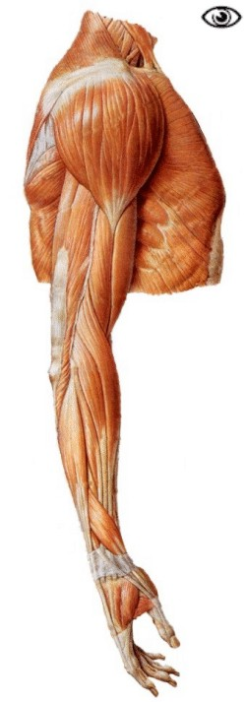
Scapula
Deltoid

Slide 3
Scapula
Deltoid
Biceps Brachii:
Prime mover for flexing the arm

Slide 4
Scapula
Deltoid
Biceps Brachii:
Prime mover for flexing the arm.
Triceps brachii:
Prime mover for arm extension.
Antagonist of biceps brachii.
Boxer’s muscle, delivers a straight knockout punch.

Slide 5
Scapula
Deltoid
Biceps Brachii:
Prime mover for flexing the arm.
Triceps brachii:
Prime mover for arm extension.
Antagonist of biceps brachii.
Boxer’s muscle, delivers a straight knockout punch.
Brachialis:
Deep to the biceps.
Elbow flexion

Slide 6
Scapula
Deltoid
Biceps Brachii:
Prime mover for flexing the arm.
Triceps brachii:
Prime mover for arm extension.
Antagonist of biceps brachii.
Boxer’s muscle, delivers a straight knockout punch.
Brachialis:
Deep to the biceps.
Elbow flexion
Brachioradialis:
Fairly weak muscle.
Forearm flexion.

Slide 7
Scapula
Deltoid
Biceps Brachii:
Prime mover for flexing the arm.
Triceps brachii:
Prime mover for arm extension.
Antagonist of biceps brachii.
Boxer’s muscle, delivers a straight knockout punch.
Brachialis:
Deep to the biceps.
Elbow flexion
Brachioradialis:
Fairly weak muscle.
Forearm flexion.
Anterior arm muscles used for flexion, in order of decreasing strength:

Slide 8
Scapula
Deltoid
Biceps Brachii:
Prime mover for flexing the arm.
Triceps brachii:
Prime mover for arm extension.
Antagonist of biceps brachii.
Boxer’s muscle, delivers a straight knockout punch.
Brachialis:
Deep to the biceps.
Elbow flexion
Brachioradialis:
Fairly weak muscle.
Forearm flexion.
Anterior arm muscles used for flexion, in order of decreasing strength:
Biceps brachii

Slide 9
Scapula
Deltoid
Biceps Brachii:
Prime mover for flexing the arm.
Triceps brachii:
Prime mover for arm extension.
Antagonist of biceps brachii.
Boxer’s muscle, delivers a straight knockout punch.
Brachialis:
Deep to the biceps.
Elbow flexion
Brachioradialis:
Fairly weak muscle.
Forearm flexion.
Anterior arm muscles used for flexion, in order of decreasing strength:
Biceps brachii
brachialis

Slide 10
Scapula
Deltoid
Biceps Brachii:
Prime mover for flexing the arm.
Triceps brachii:
Prime mover for arm extension.
Antagonist of biceps brachii.
Boxer’s muscle, delivers a straight knockout punch.
Brachialis:
Deep to the biceps.
Elbow flexion
Brachioradialis:
Fairly weak muscle.
Forearm flexion.
Anterior arm muscles used for flexion, in order of decreasing strength:
Biceps brachii
Brachialis
brachioradialis

Slide 11
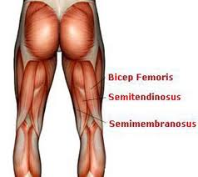
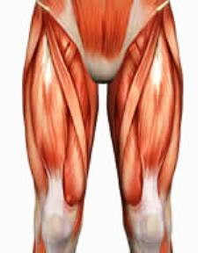
Muscles that move the knee
1.) Hamstrings:
Mass of muscles, flexes the knee
2.) Sartorius: Weak thigh flexor
Rectus Femoris
Vastus Medialis
3.) Quadriceps: 4 muscles on the anterior thigh that extend the knee
Vastus Lateralis
Vastus Intermedialis (under R. Femoris)

Slide 12
Muscles moving the hip
Gluteus Medius:
Beneath the Gluteus Maximus
Hip abductor
Steadies the pelvis
Site for intramuscular injections
Gluteus Maximus:
Superficial muscle of the hip
Powerful hip extensor
Important for climbing stairs and jumping

Slide 13
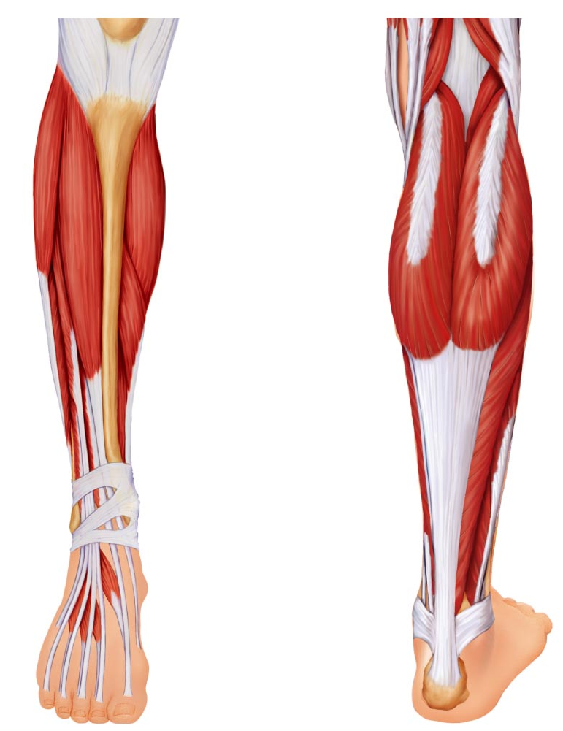
Muscles that move the ankles and feet
Tibialis anterior:
Allows you to invert the foot (turn foot medial side up)
Gastrocnemius: 2 bellied muscle. Allows you to point your foot and push off the ball of the foot. Running, dancing muscle.
Fibularis: 3 muscles of the anterior calf that allow you to evert the foot (turns sole laterally)
Soleus: Deep to gastrocnemius. Strong muscles for flexion of heel (pointing of toes)

