Slide 1
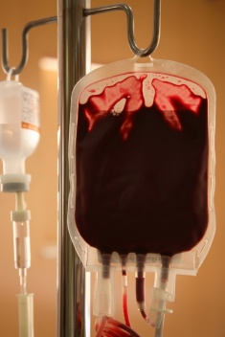
Blood Typing

Slide 2
If you lose more than 15-30% of your blood, pallor and weakness will result.

Slide 3
If you lose more than 15-30% of your blood, pallor and weakness will result.
More than 30% will result in shock and possibly death.

Slide 4
If you lose more than 15-30% of your blood, pallor and weakness will result.
More than 30% will result in shock and possibly death.
Whole blood transfusions are given to replace substantial blood loss and treat severe anemia.

Slide 5
If you lose more than 15-30% of your blood, pallor and weakness will result.
More than 30% will result in shock and possibly death.
Whole blood transfusions are given to replace substantial blood loss and treat severe anemia.
Blood is collected, an anti coagulant is added
to prevent clotting, and it is stored in a
refrigerator for up to 35 days at 4ºC.

Slide 6
If you lose more than 15-30% of your blood, pallor and weakness will result.
More than 30% will result in shock and possibly death.
Whole blood transfusions are given to replace substantial blood loss and treat severe anemia.
Blood is collected, an anti coagulant is added
to prevent clotting, and it is stored in a
refrigerator for up to 35 days at 4ºC.
Must get the correct blood type because the
plasma membranes of red blood cells (RBC’s)
have genetically determined proteins or
antigens.

Slide 7
Red Blood Cells (RBC’s)
An antigen is protein that the body sees as foreign and the immune system releases antibodies against them.

Slide 8
Red Blood Cells (RBC’s)
An antigen is protein that the body sees as foreign and the immune system releases antibodies against them.
We can tolerate proteins for our blood type, but another type is foreign and will be attacked by our immune system.

Slide 9
Red Blood Cells (RBC’s)
An antigen is protein that the body sees as foreign and the immune system releases antibodies against them.
We can tolerate proteins for our blood type, but another type is foreign and will be attacked by our immune system.
Causes agglutination, or clumping, which clogs small blood vessels.

Slide 10
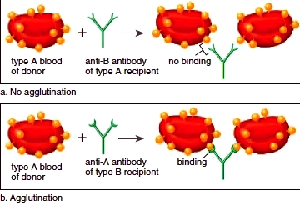
Agglutination
Antibodies are present in the plasma which will attack RBC’s with surface antigens that are not the same as the individual’s blood type.

Slide 11
ABO Blood Types
The A blood type is found in about 41% of the American population.
Can receive blood from A and O
donors.

Slide 12
ABO Blood Types
The B blood type is found in about 10% of the American population.
Can receive blood from B and O
donors.

Slide 13
ABO Blood Types
The AB blood type is found in about 4% of the American population.
Can receive blood from A, B, AB,
and O donors.

Slide 14
ABO Blood Types
The O blood type is found in about 44% of the American population.
Can receive blood from O donors.

Slide 15
Rh Factor
Rh+ 85% of the population
Rh- No antibodies are normally present. If an Rh- individual receives RH+ blood, anti Rh+ antibodies will be produced.
If individual receives a second Rh+ blood transfusion, antibodies will attack and rupture the Rh+ blood.

Slide 16
Important Rh Factor Problem
If an Rh- woman has an Rh+ baby, her immune system will produce anti Rh+ antibodies after exposure to the fetal blood in the placental bloodstream.
Mothers are treated with Rhogam during pregnancy and after delivery to prevent the formation of these antibodies.
Without treatment, mother’s antibodies could kill baby and complicate future pregnancies.

