Slide 1
Domain 3: Energy

Slide 2
1. Bioenergetic Theory
3.1: All living systems require constant input of free energy.

Slide 3
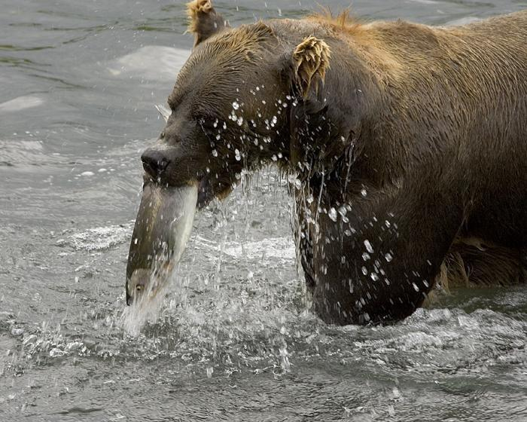
The First Law of Thermodynamics
Energy cannot be created or destroyed, only transformed.
Living systems need to continually acquire and transform energy
in order to remain
alive.
“Free energy”: The
energy available in a
system to do work.

Slide 4
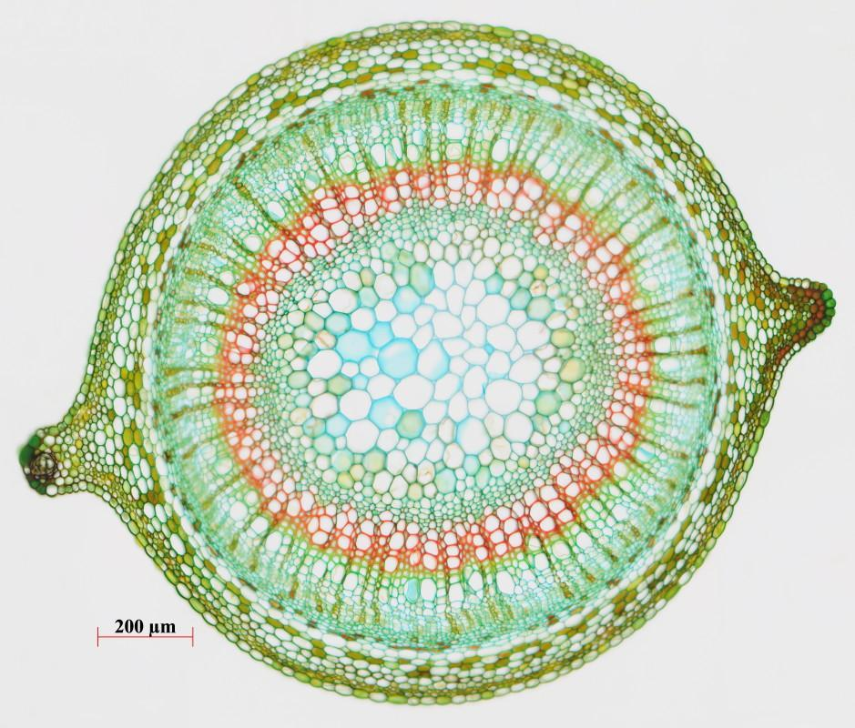
The Second Law of Thermodynamics
Every time energy is transformed, the entropy (“disorder”) of the universe increases.
In order to increase/
maintain their internal
order, living systems
must process more
ordered forms of
matter in to less
ordered ones

Slide 5
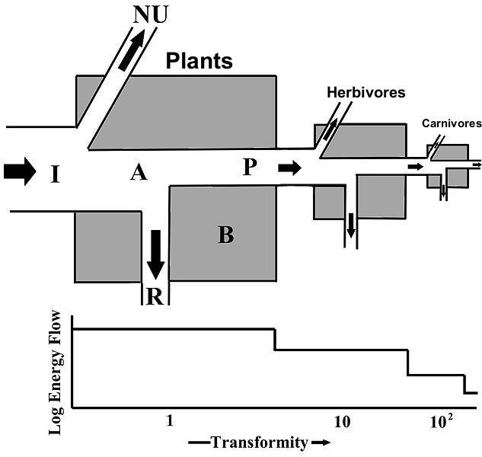
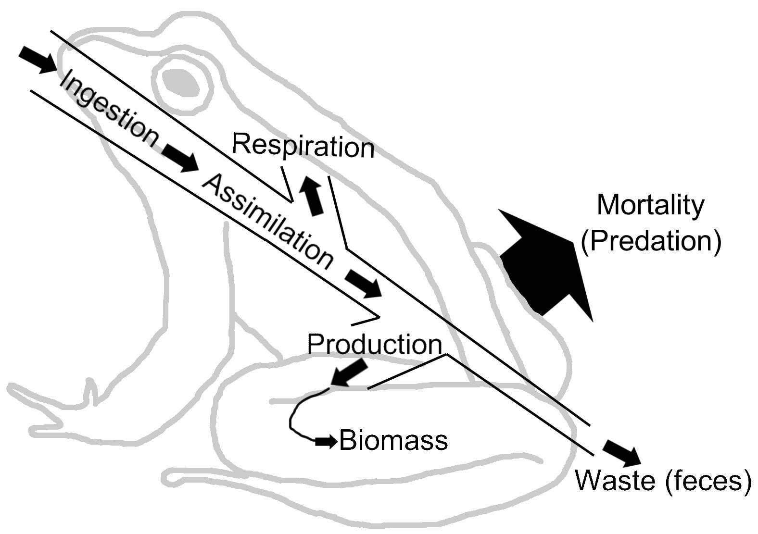
Living Systems are “Open” Systems
Matter and energy move in to living systems from the environment. Living systems transform matter and energy and return it to the environment

Slide 6
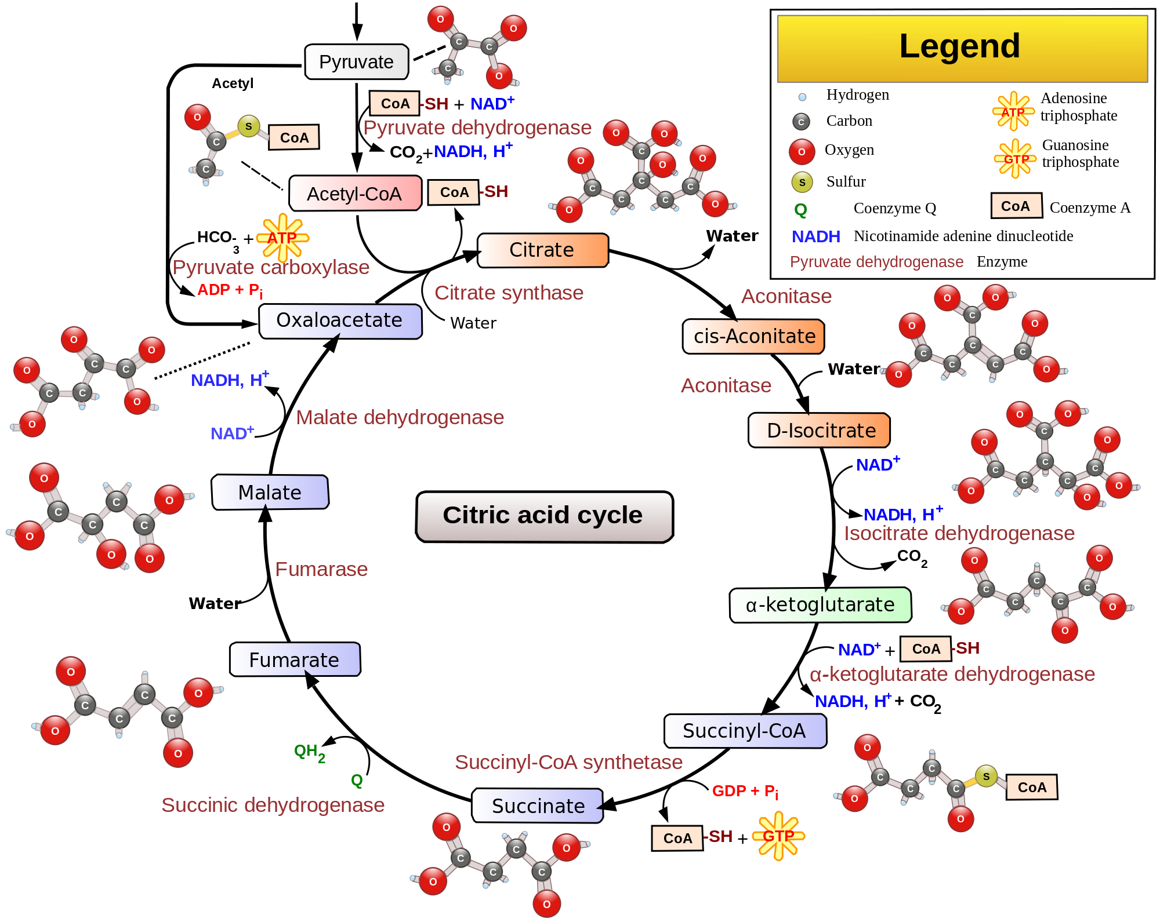
Multi-Step Metabolism
To increase control, living systems produce free energy in multiple-step pathways, mediated by enzyme catalysts.

Slide 7
2. Math Skills: Gibbs Free Energy
3.1: All living systems require constant input of free energy.

Slide 8
What You Have To Do
Be able to use and interpret the Gibbs Free Energy Equation to determine if a particular process will occur spontaneously or non-spontaneously.
ΔG= change in free energy (- = exergonic, + = endergonic)
ΔH= change in enthalpy for the reaction (- = exothermic, + = endothermic)
T = kelvin temperature
ΔS = change in entropy (+ = entropy increase, - = entropy decrease)

Slide 9
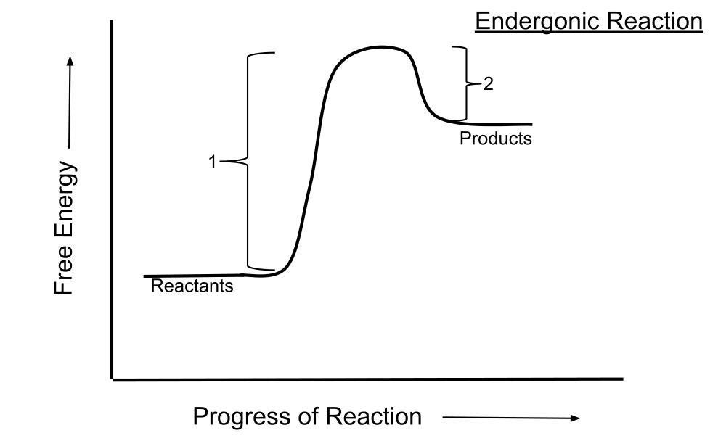
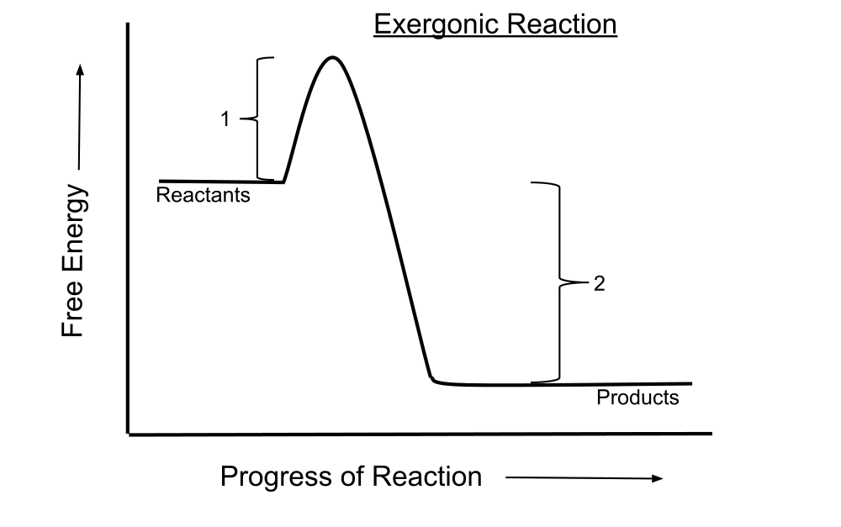
Spontaneity
Spontaneous reactions continue once they are initiated. Non-spontaneous reactions require continual input of energy to continue.

Slide 10
Using the Equation
To use the equation, you’ll need to be given values.
Exothermic reactions that increase entropy are always spontaneous/exergonic
Endothermic reactions that decrease entropy are always non-spontaneous/endergonic.
Other reactions will be spontaneous or not depending on the temperature at which they occur.

Slide 11
Sample Problem
Determine which of the following reactions will occur spontaneously at a temperature of 298K, justify your answer mathematically:
Reaction 1:
A + B → AB
Δ H: +245 KJ/mol
Δ S: -.02 KJ / K
Reaction 2:
BC → B + C
Δ H: -334 KJ/mol
Δ S: +.12 KJ/K

Slide 12
3. Metabolic Strategies
3.1: All living systems require constant input of free energy.

Slide 13
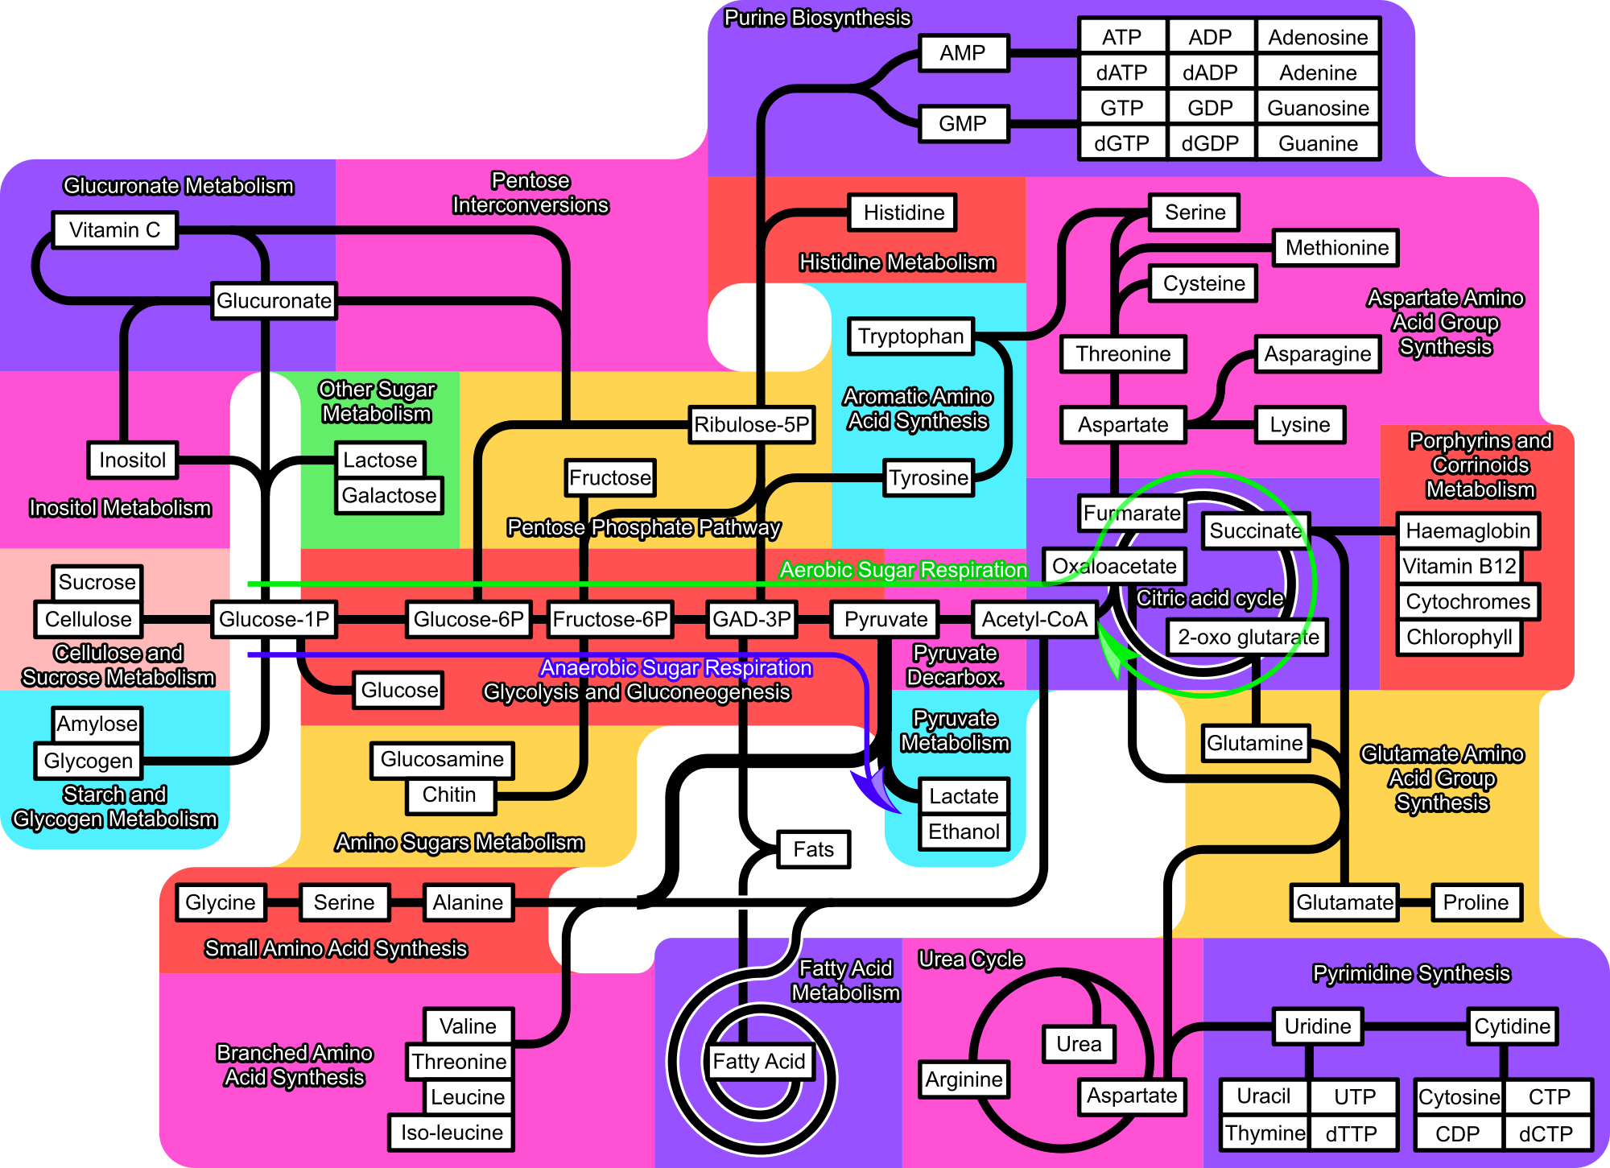
Uses of Biological Free Energy
To accomplish cellular work (“metabolism”). Repair, growth, and reproduction.
Catabolism:
Decomposing
Anabolism:
Synthesis

Slide 15
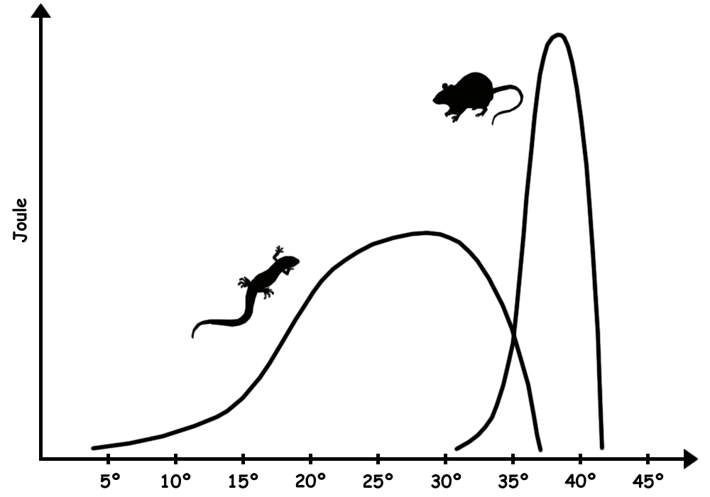
Metabolic Strategies
Ectothermy: Conform internal temperature to environmental temperature.
Endothermy: Regulate internal temperature within a narrow range.
Both strategies have advantages and tradeoffs.

Slide 16
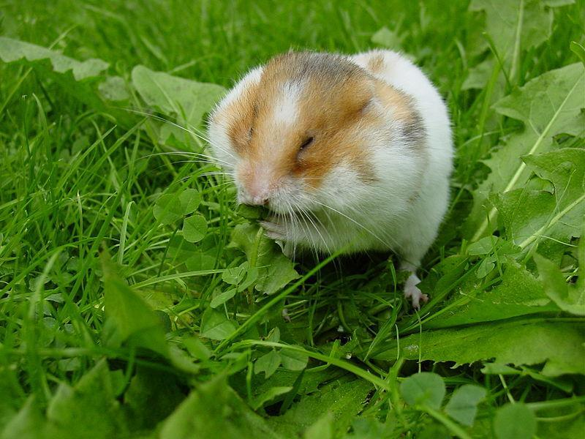
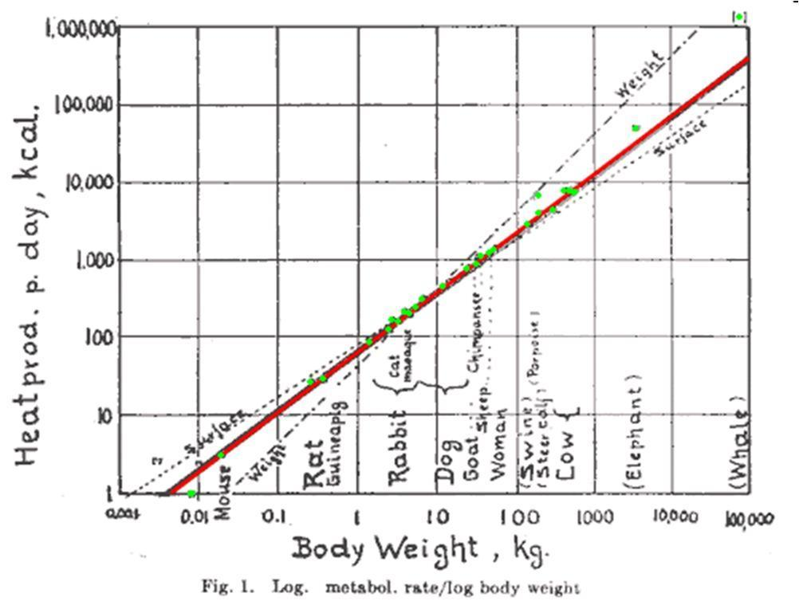
Body Size Considerations
Smaller animals need to produce more energy per unit of mass due to increased radiation of heat into the environment.

Slide 17
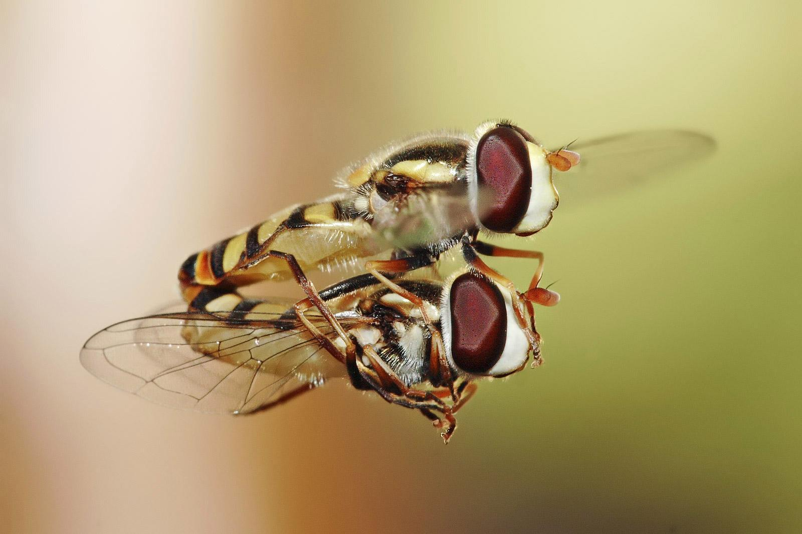
Free Energy Considerations & Reproduction
Reproductive strategies are optimized for free energy considerations.
Ex. Seasonal Reproduction.

Slide 18
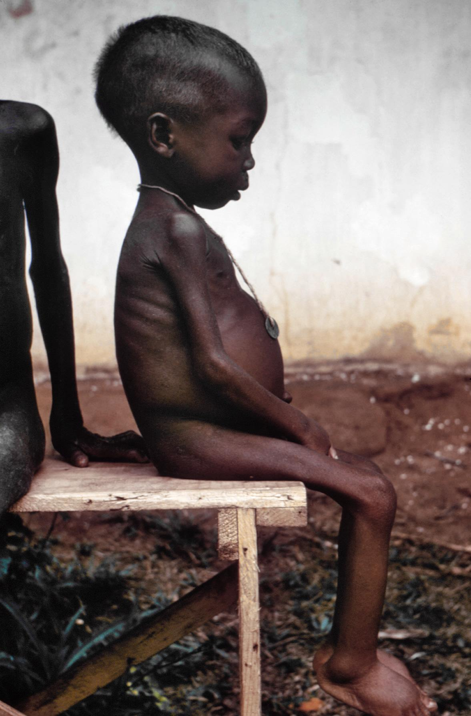
Insufficient Free Energy Production: Individuals
Insufficient free energy production by individuals will lead to disease and death.

Slide 19
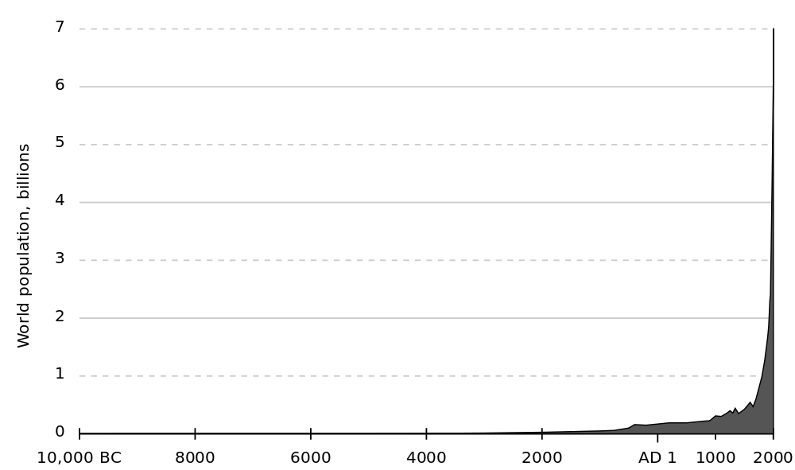
Insufficient Free Energy Production: Populations
If the individuals in the population are unable to survive, the growth rate of the population will decline

Slide 20
Insufficient Free Energy Production: Ecosystems
If the populations in an ecosystem decline, the ecosystems will decrease in complexity

Slide 21
4. Math Skills: Coefficient q₁₀
3.1: All living systems require constant input of free energy.

Slide 22
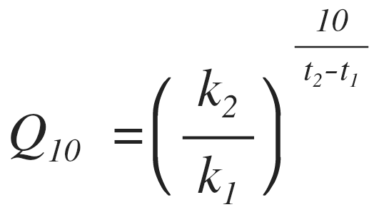
What You Have To Do
Be able to use and interpret the Coefficient Q₁₀ equation:
t₂ = higher temperature
t₁ = lower temperature
k₂= metabolic rate at higher temperature
k₁= metabolic rate at lower temperature
Q₁₀ = the factor by which the reaction rate increases when the temperature is raised by ten degrees.

Slide 23
What It Means
Q₁₀ tells us how a particular process will be affected by a 10 degree change in temperature.
Most biological processes have a Q₁₀ value between 2 and 3

Slide 24
Sample Problem
Data taken to determine the effect of temperature on the rate of respiration in a goldfish is given in the table below. Calculate the Q10 value for this data.
Temperature (°C) | Heartbeats per minute
20 | 18
25 | 42

Slide 25
1. Enzyme Structure and Function
3.2: Interactions between molecules affect their structure and function.

Slide 26
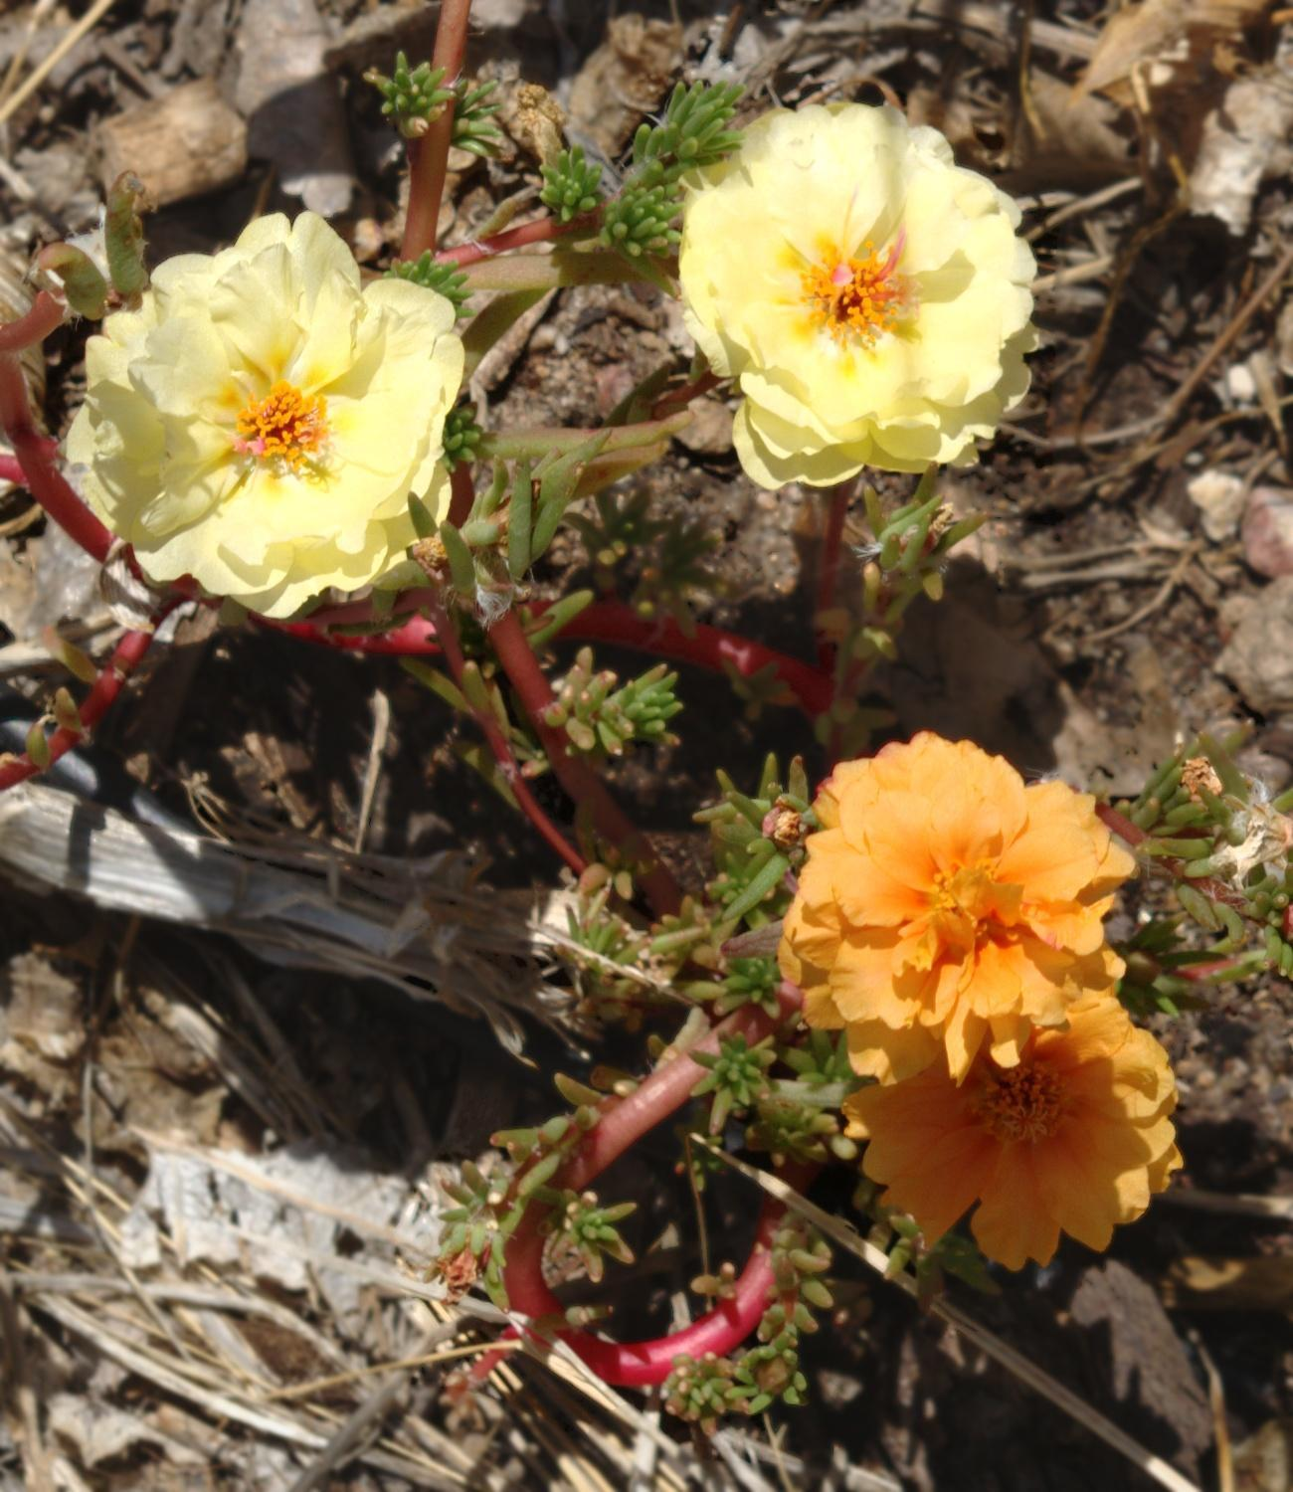
Structure and Function
Structure always determines function.
Molecular interactions lead to organism phenotypes.

Slide 27
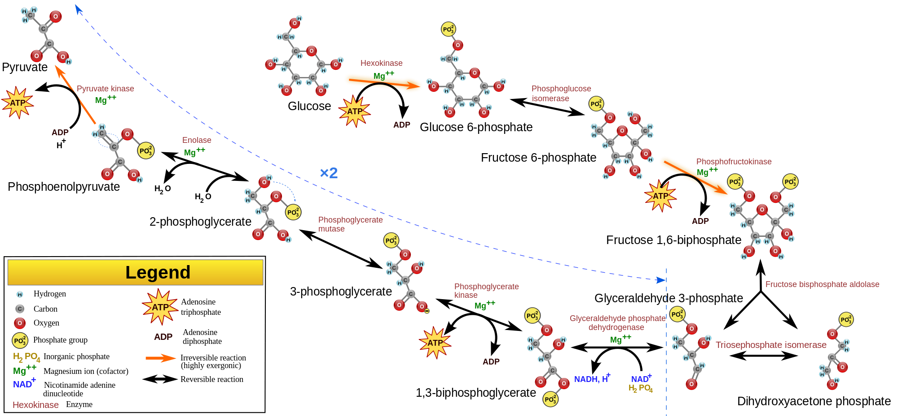
Metabolism is Controlled by Enzymes

Slide 28
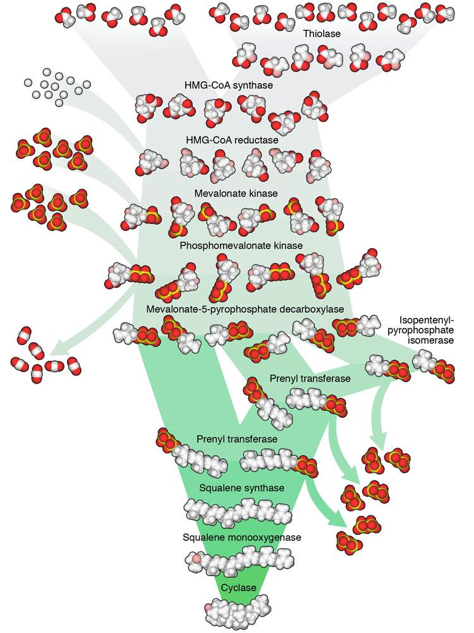
More Steps = More Control = More Complexity
Image by David S. Goodsell, The Scripps Research Institute. All rights reserved.

Slide 29
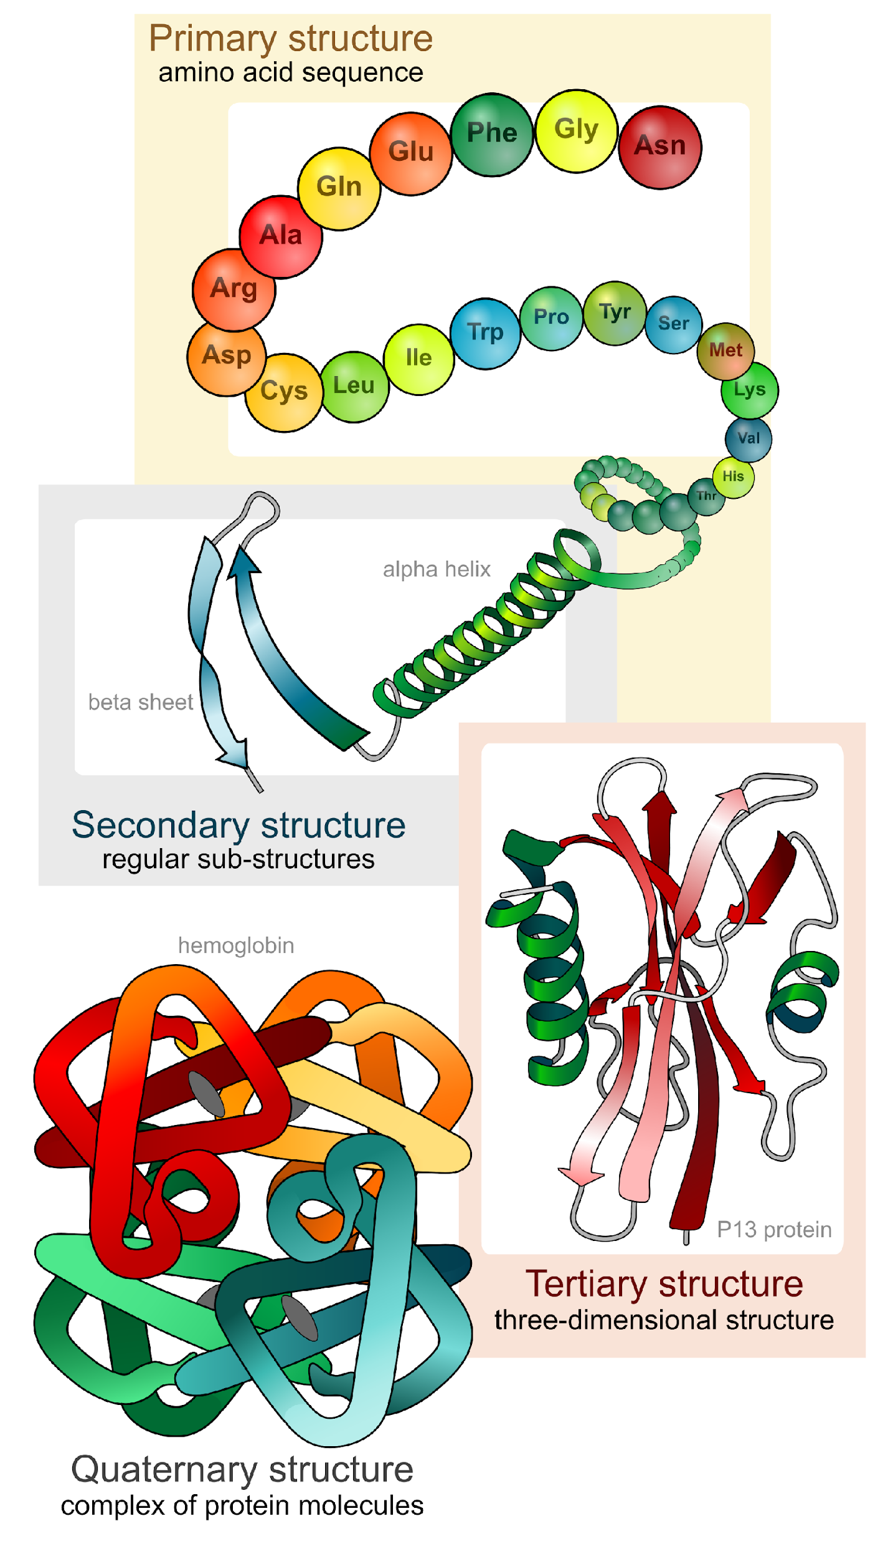
Enzymes are (mostly) Proteins
Enzymes are molecules that serve as biological catalysts.
Some RNA molecules also have catalytic properties.

Slide 30
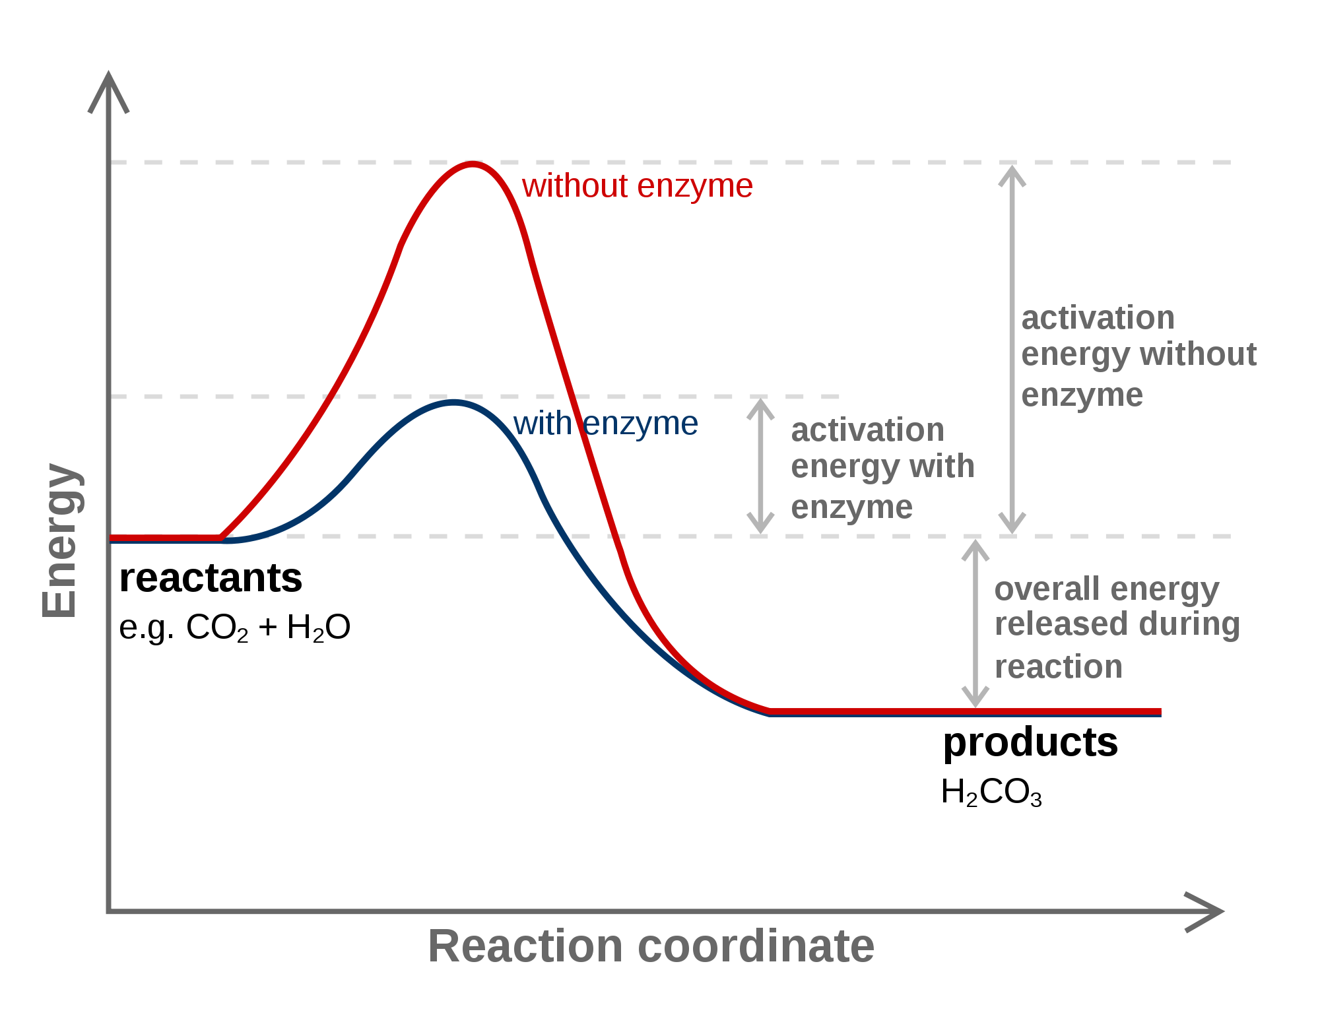
Catalysis
Catalysts: Substances that increase the rate of a chemical reaction by lowering the activation energy of the reaction, without participating in the reaction.

Slide 31
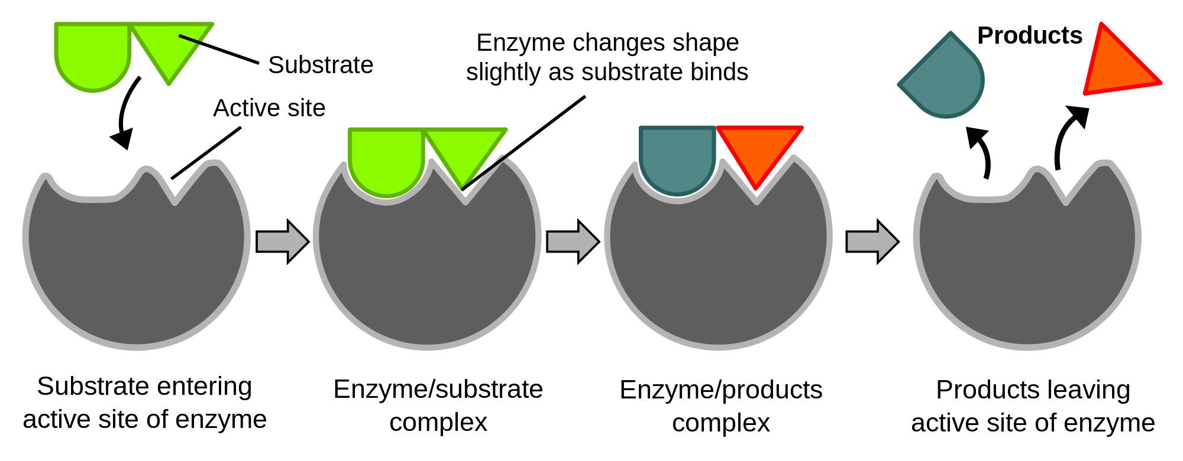
Enzymes work by physically positioning reactants (“substrate”) in ways that increase the likelihood of chemical bonds being broken or formed.
Enzymes are highly specific for the substrates that they interact with. The name of an enzyme tells you about its substrate in the first part of its name, and ends in –ase. (Ex. lipase)

Slide 32
Induced Fit Model:
Substrate molecules physically bind to an area of the enzyme called the “active site”. The binding causes the conformation of the enzyme to change slightly, catalyzing the reaction.

Slide 33
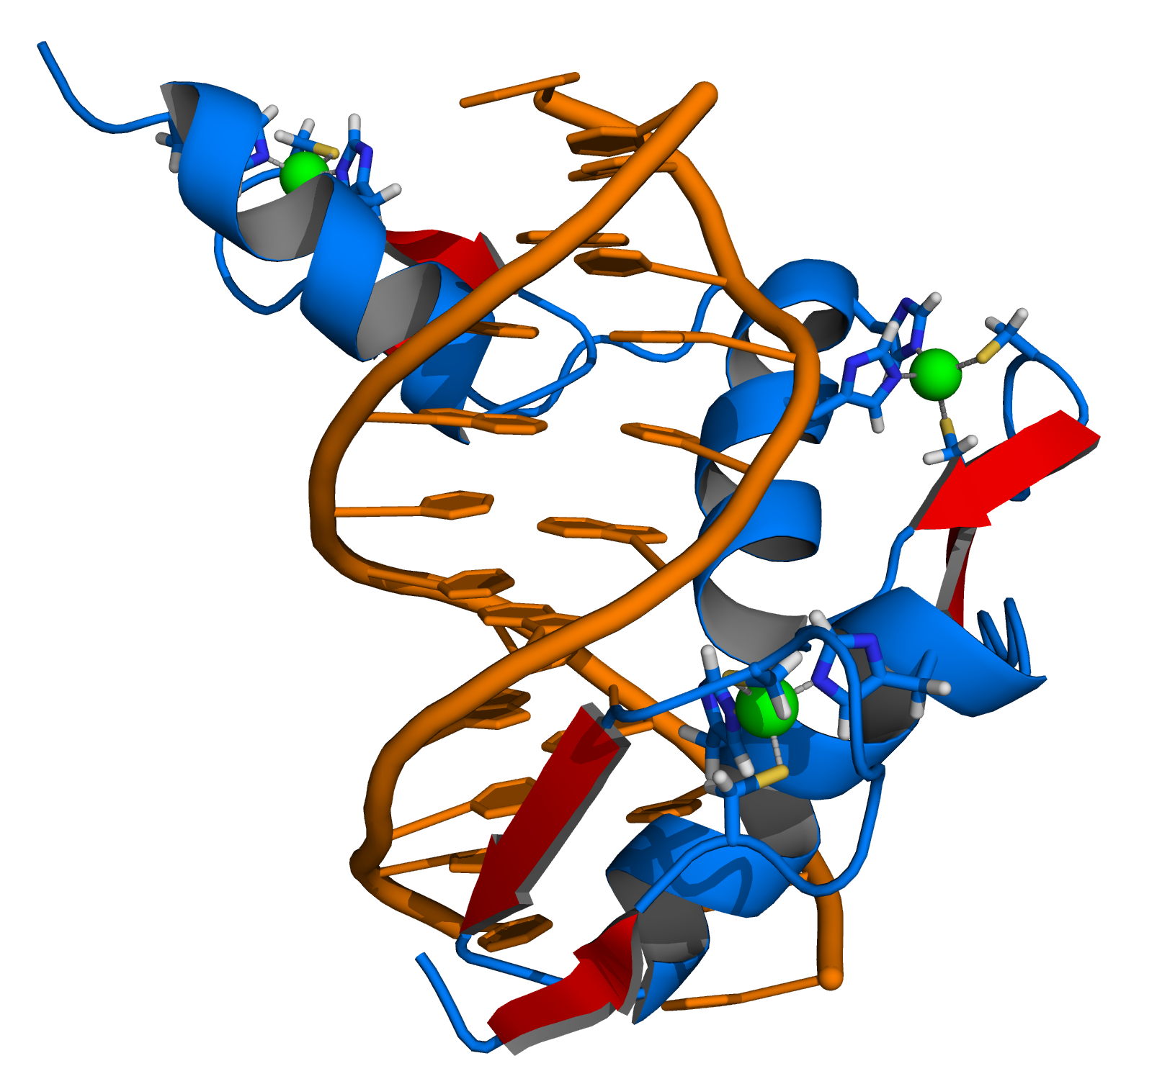
Co-factors/Co-enzymes
many enzymes require organic (co-enzymes: “vitamins”) or inorganic (co-factors: “minerals”) groups of atoms to be complexed with the enzyme.
Ex. Many enzymes involved in interacting with DNA require zinc²⁺ ions as co-factors (green spheres).

Slide 34
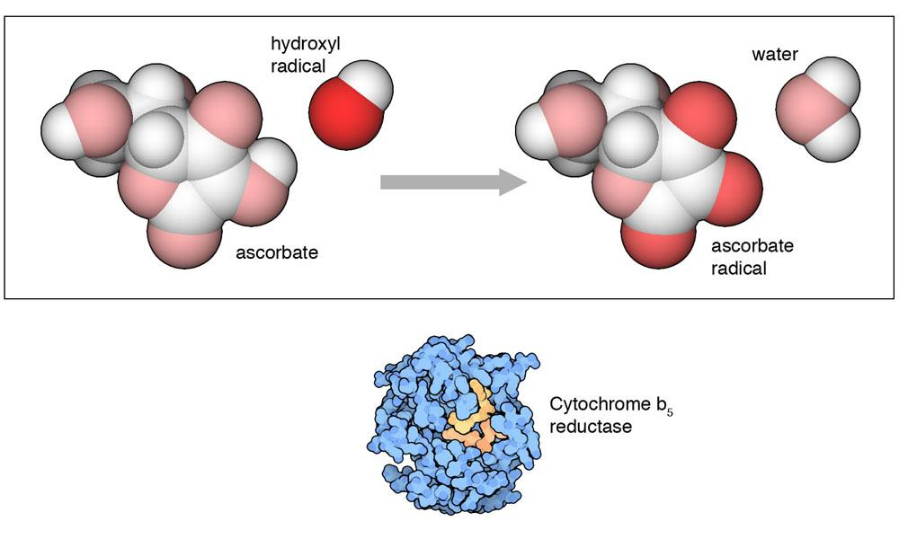
Ex. Vitamin C
Image by David S. Goodsell, The Scripps Research Institute. All rights reserved.

Slide 35
2. Regulation of Enzyme Activity
3.2: Interactions between molecules affect their structure and function.

Slide 36
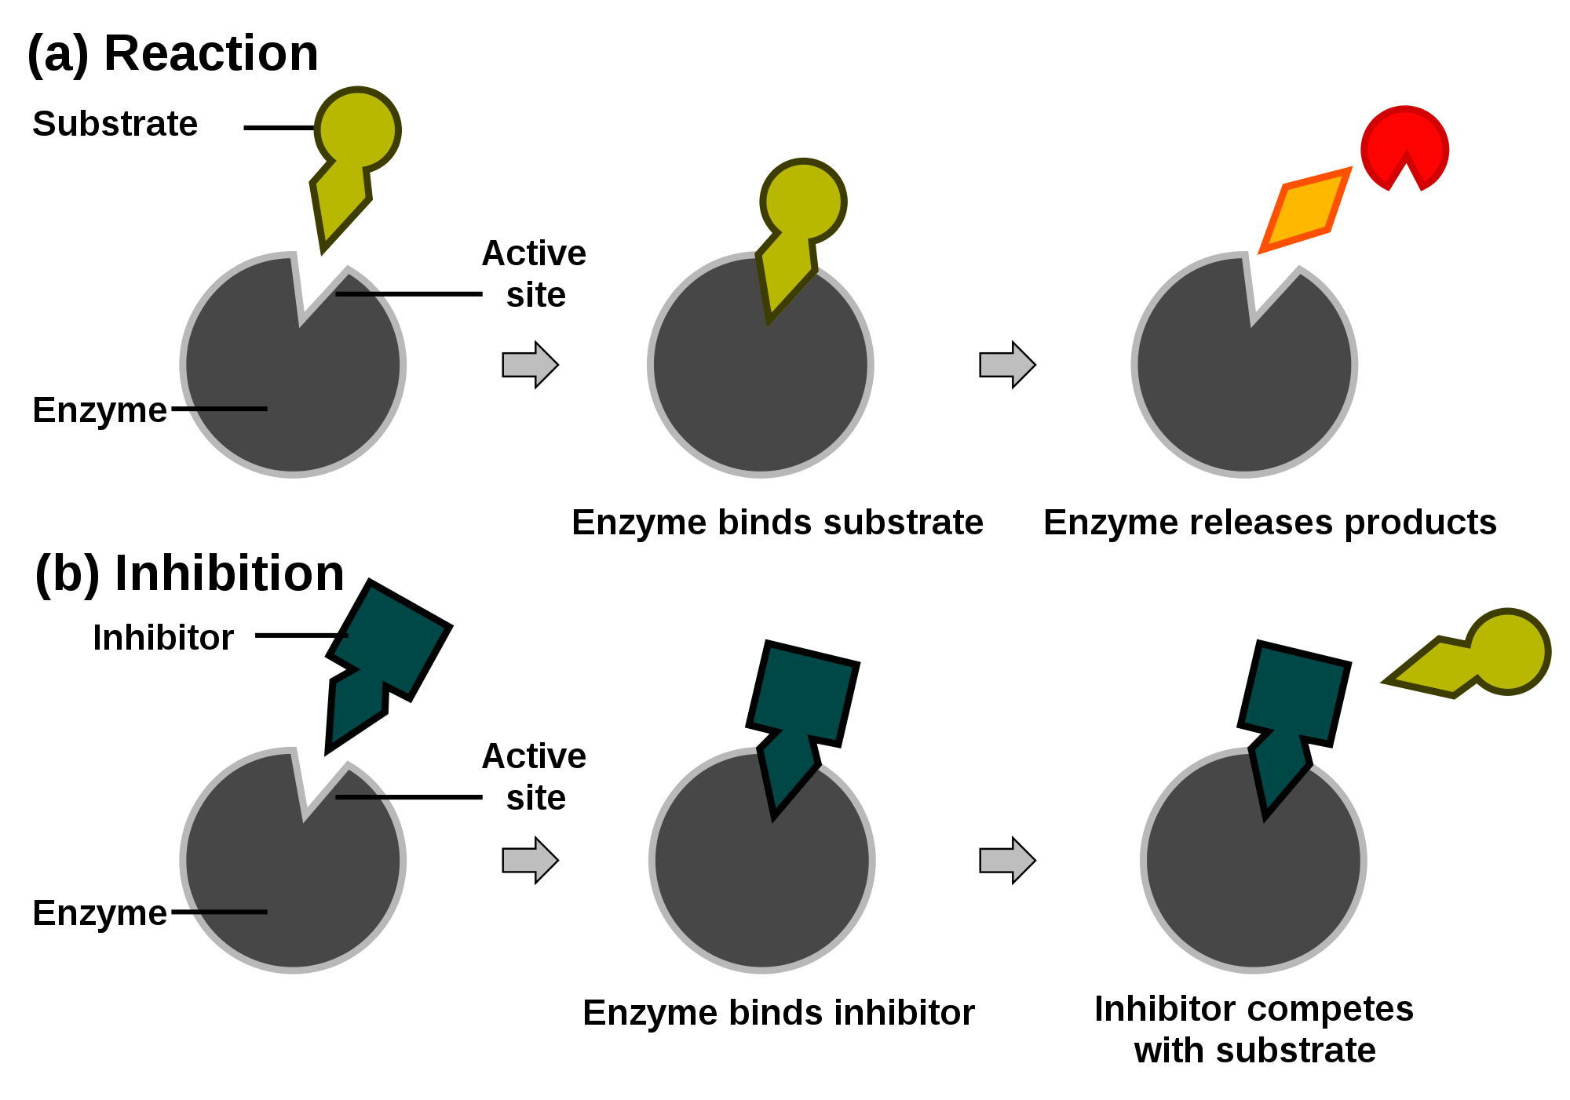
Other Molecules Can Affect Enzyme Structure and Function.
Competitive Inhibition:

Slide 37
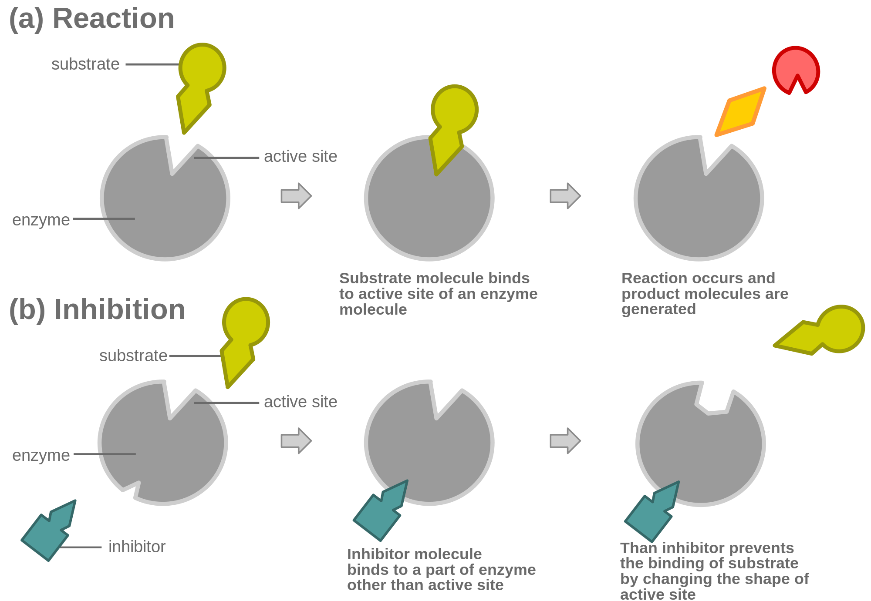
Non-Competitive Inhibition.
“Allosteric Interaction”: Affects enzyme structure through binding away from the active site.

Slide 38
Allosteric Interactions allow for feedback inhibition of metabolism
Ex. ATP inhibits the activity of phosphofructokinase.

Slide 39
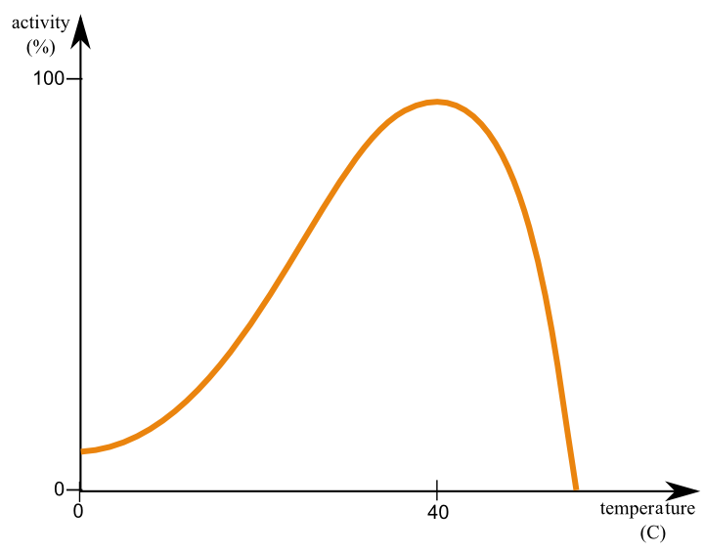
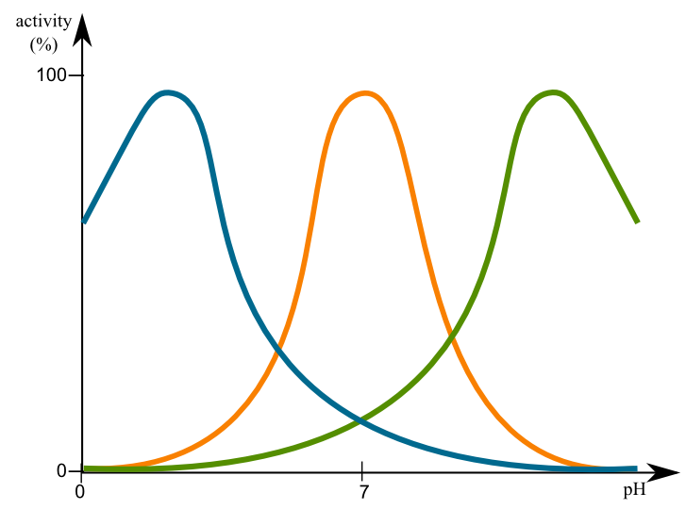
Environmental Influences on Enzyme Function
The local environment can affect the shape of the enzyme, which will affect its function.
Ex. Temperature and pH.

Slide 40
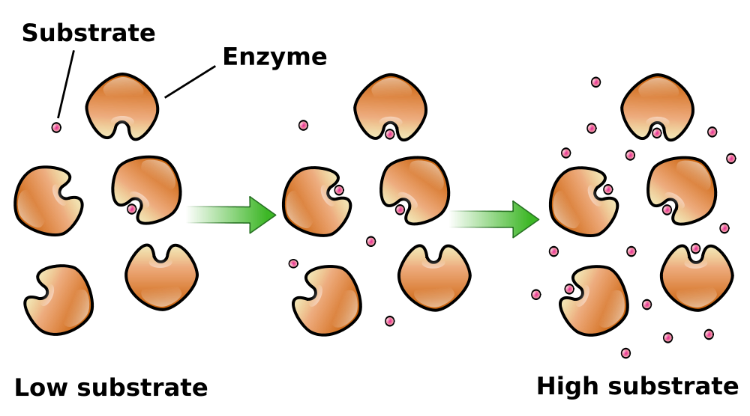
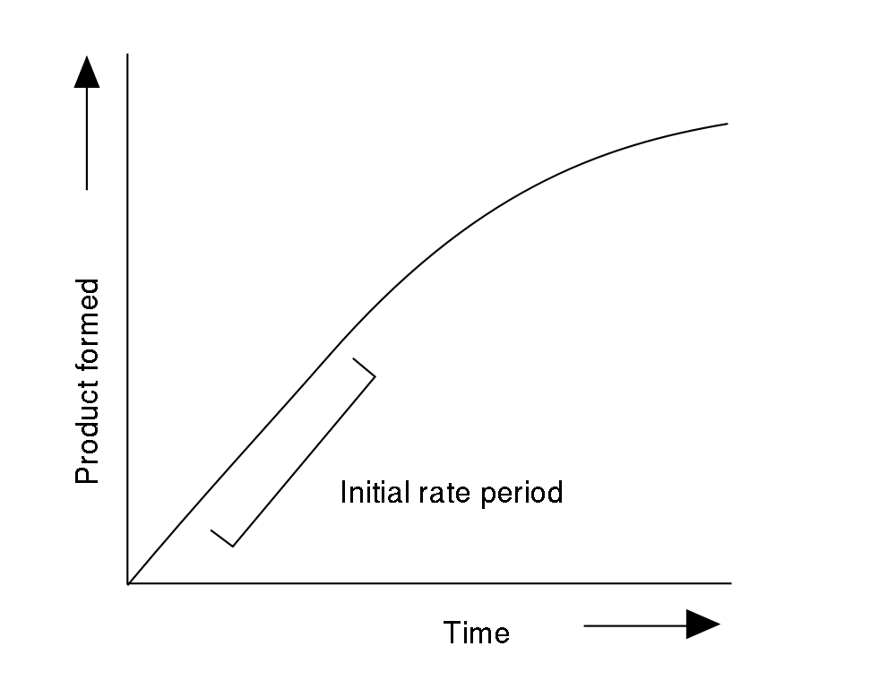
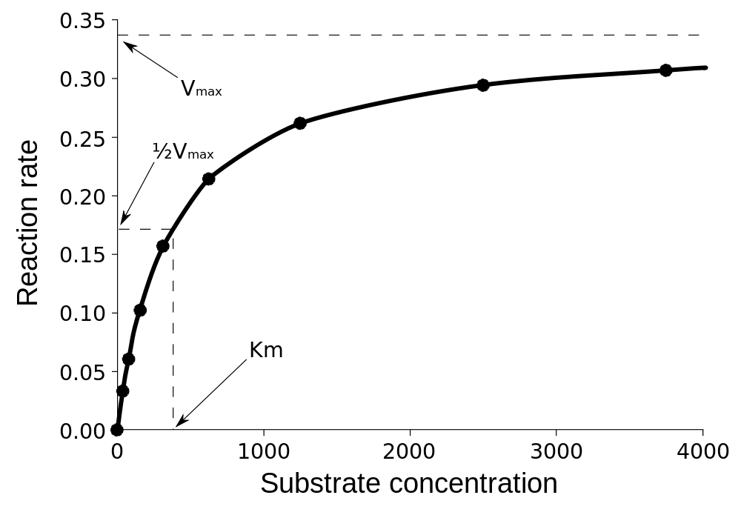
Concentration Influences on Enzyme Function
The concentration of enzyme and substrate will also affect enzyme function.

Slide 41
Measuring Enzyme Activity
Enzyme Activity can be measured in different ways:
Appearance of a product
Disappearance of a substrate
Indirect Analogs: Ex. Color Change, Change in Temp.

Slide 42
1. Energy Processing
3.3: Organisms capture and store free energy for use in biological processes.

Slide 43
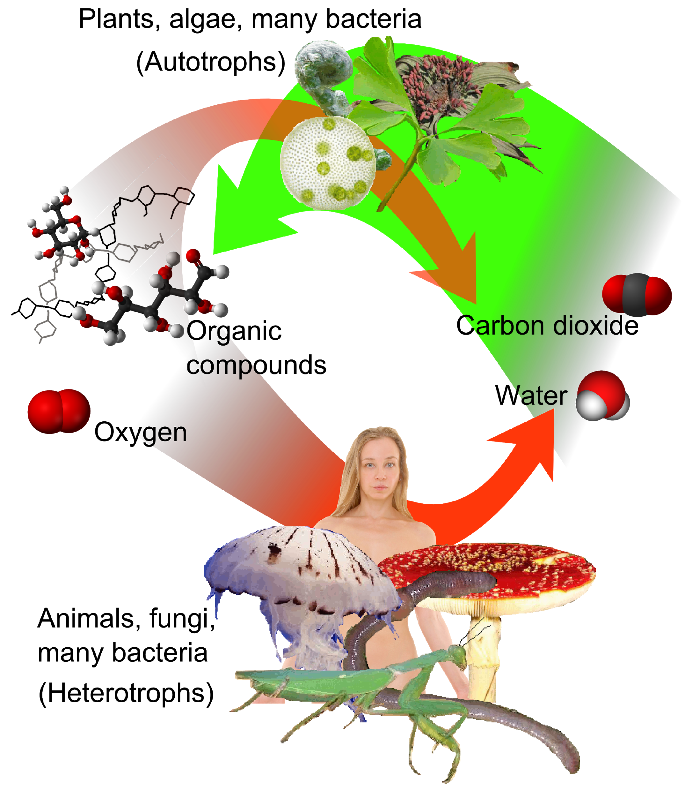
Autotroph Energy Strategies
Autotrophs: use energy from the environment to convert inorganic molecules into organic compounds where free energy is stored. They are the producers in all food chains on Earth.
Photosynthetic organisms: Use visible light energy to convert CO₂ and H₂O into sugar precursors
Ex. all plants, and phytoplankton.
Chemosynthetic organisms: Use high energy inorganic compounds
Ex. hydrothermal vent bacteria

Slide 44
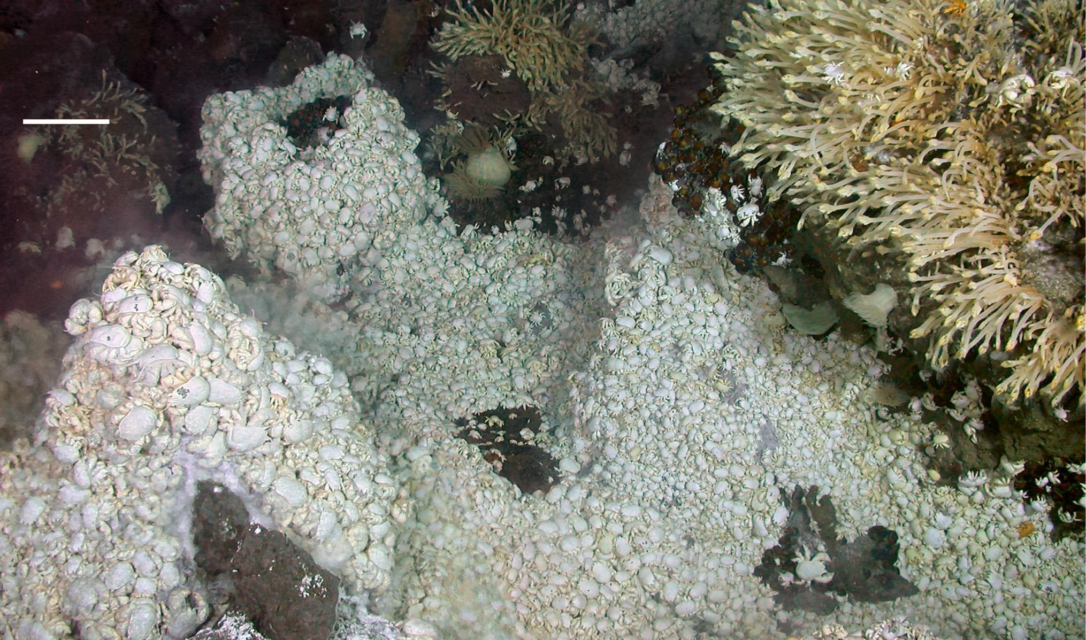
Chemosynthetic Hydrothermal Vent Community.

Slide 45
Heterotroph Energy Strategies
Heterotrophs: release free energy from organic compounds (from the food chain, either autotrophs or other heterotrophs), and convert those organic compounds in to inorganic compounds.
Anaerobic heterotrophs: Do not require oxygen. Ex. many bacteria, yeast (facultative anaerobes: can do it if they have to).
Aerobic heterotrophs: Use oxygen. Release ~20X more free energy from food molecules than anaerobes do. Ex. all multicellular fungi and animals (plants, too).

Slide 46
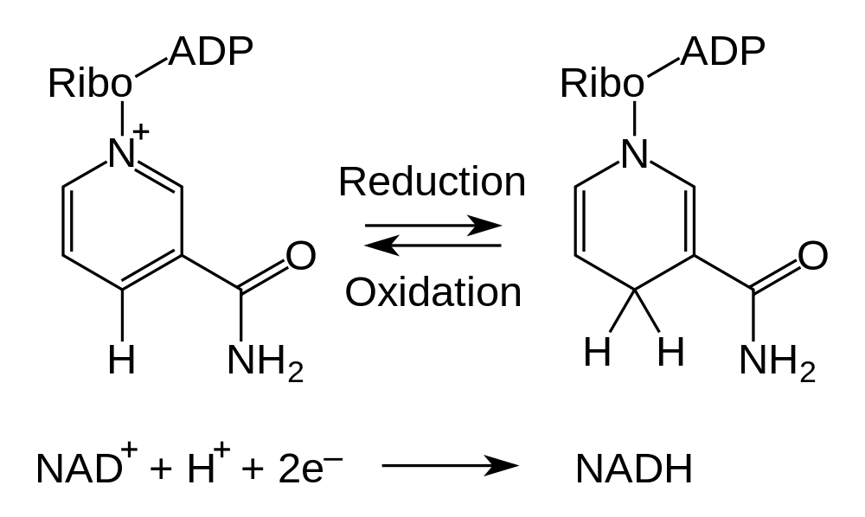
Electron Shuttles
Biological energy production utilizes reduction/oxidation reactions.
The transfer of electrons occurs via “electron shuttle” molecules.
Ex. NAD⁺/NADH, FAD/FADH₂, NADP⁺/NADPH

Slide 47
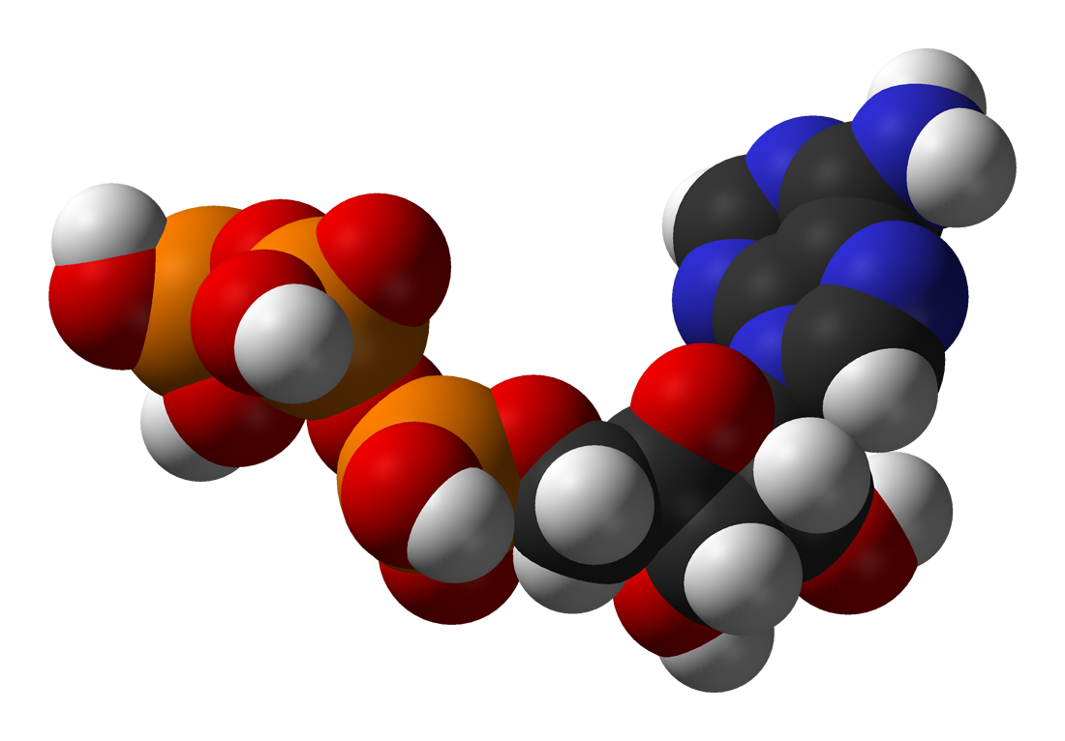
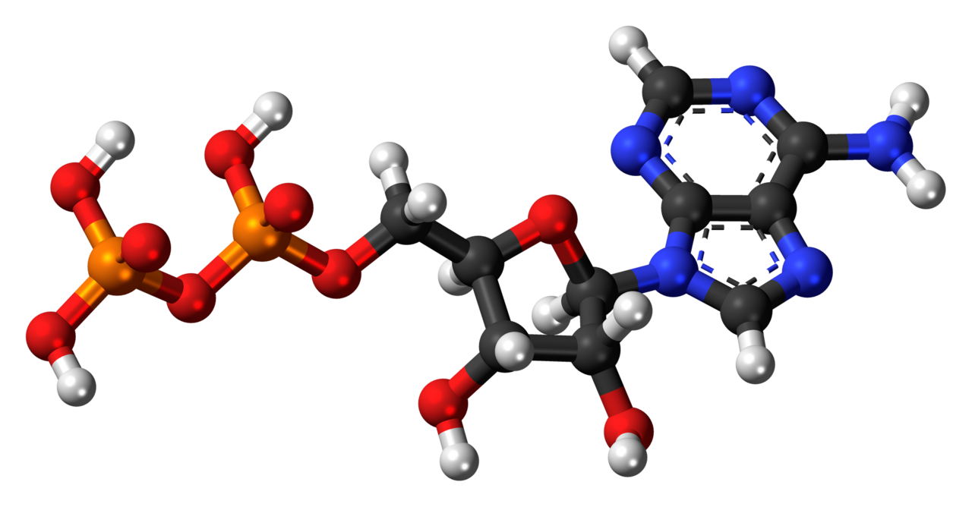
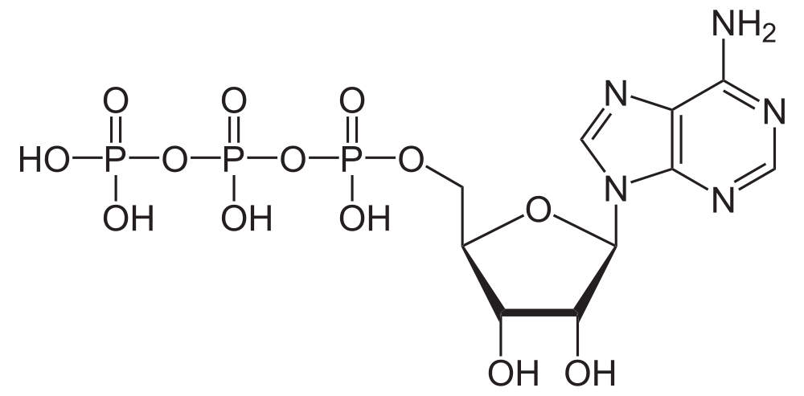
ATP
ATP: short-term free energy storage molecule used in all biological systems.
Free energy from metabolism is used to turn a molecule of ADP (2 phosphates) in to a molecule of ATP (3 phosphates).
The bond between the 2nd and 3rd phosphate is easily broken.
When it is broken, the free energy that is released is used to power cellular work.

Slide 48
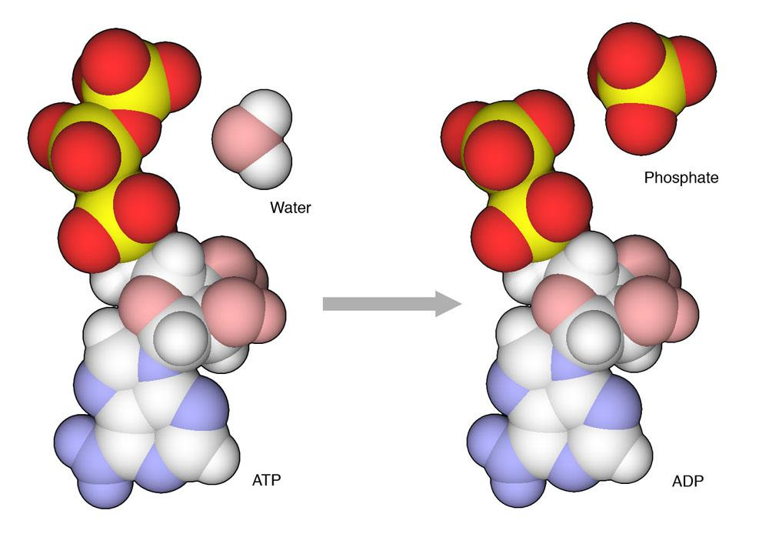
Cellular Work
Cellular Energetics (R & P)
Image by David S. Goodsell, The Scripps Research Institute. All rights reserved.

Slide 49
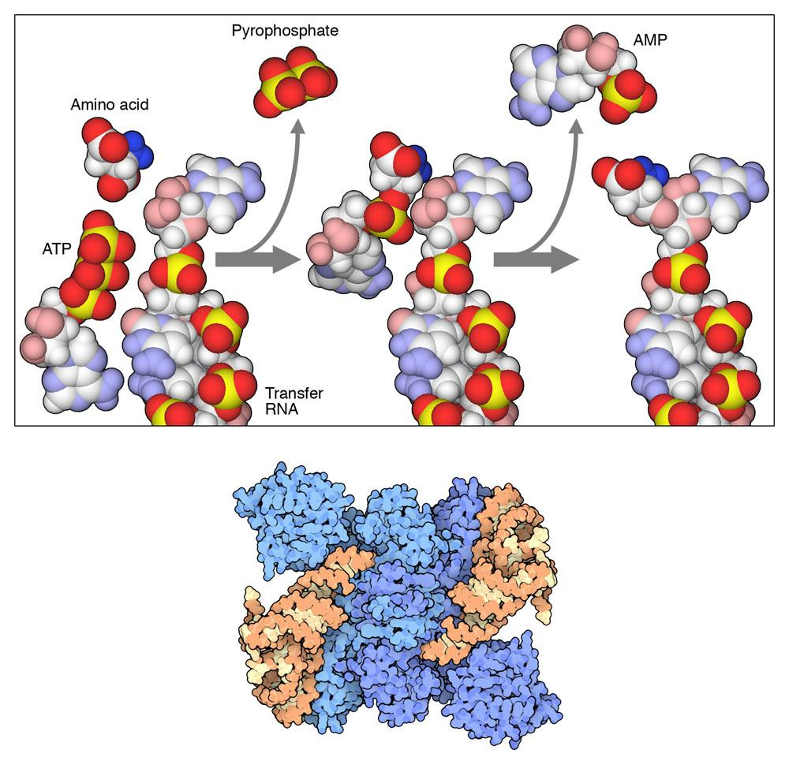
One Example of Cellular Work
“Charging” of tRNA molecules with amino acids.
Image by David S. Goodsell, The Scripps Research Institute. All rights reserved.

