Slide 1
Domain 3: Energy
Part 3

Slide 2
Cooperative Energetic Strategies
3.4: Cooperative interactions within organisms promote efficiency in the use of energy and matter.

Slide 3
Compartmentalization in Energy Processing
Compartmentalization allows for increased cellular efficiency.
Different metabolic pathways can occur in different cellular compartments, at different conditions, and not interfere with each other.
Groups of related enzymes can also be localized to particular areas.

Slide 4
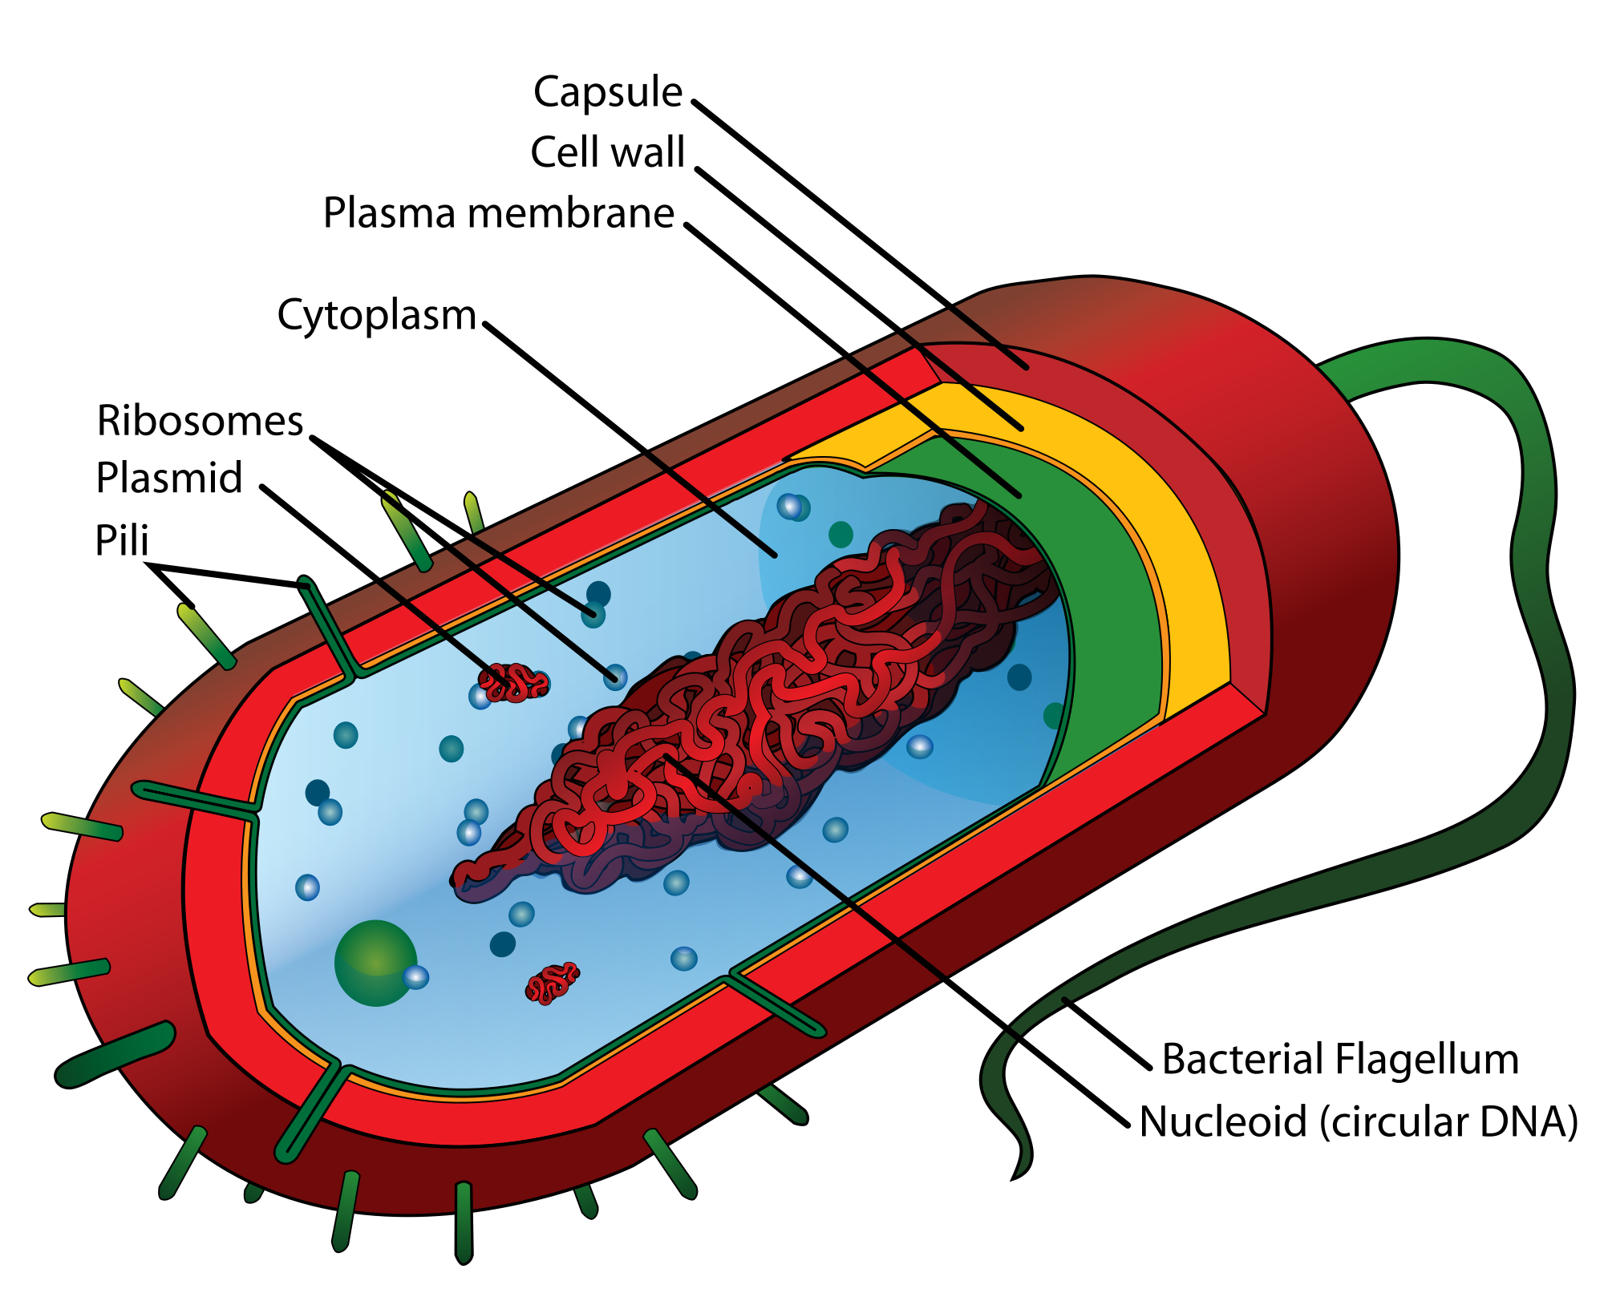
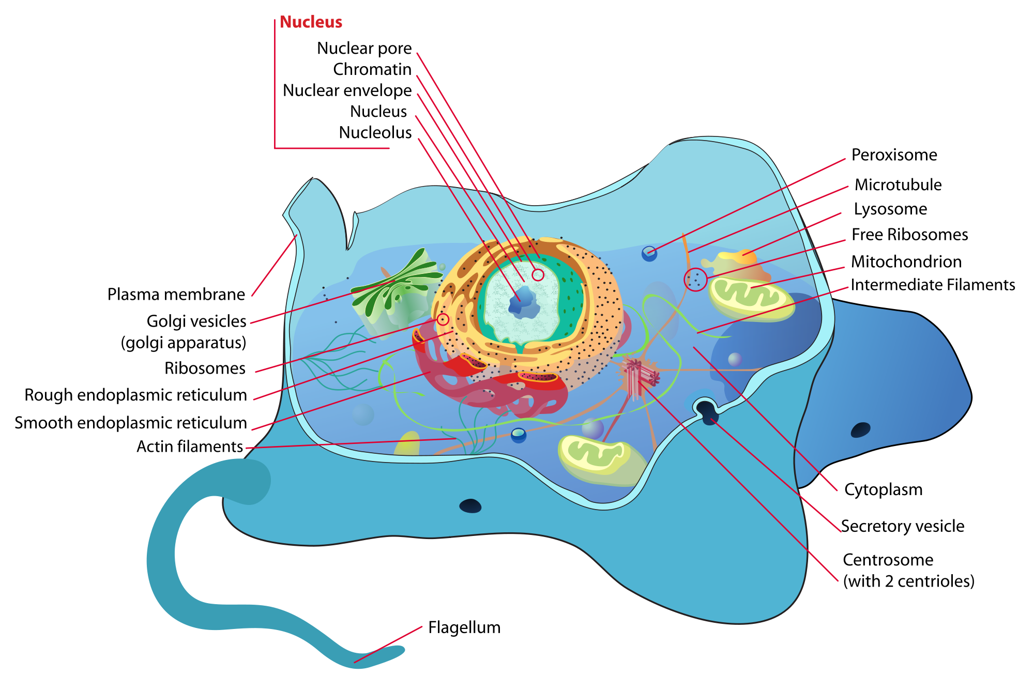
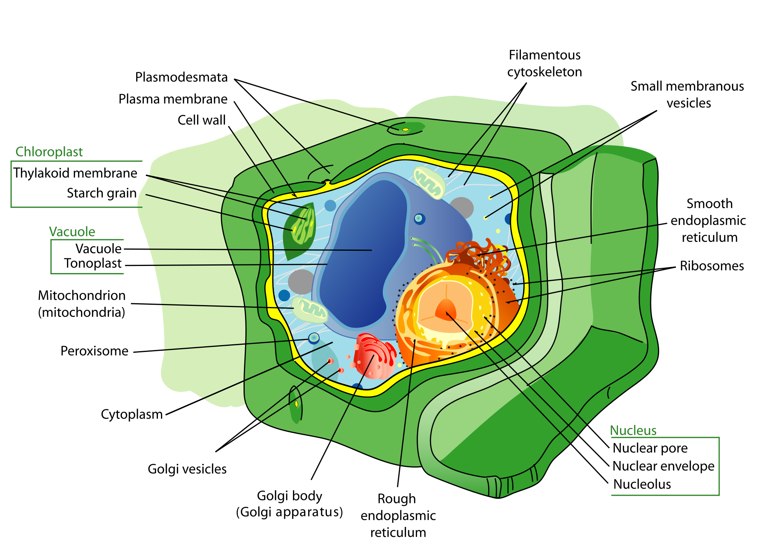
Prokaryotes vs. Eukaryotes
The increased compartmentalization of eukaryotes leads to increased complexity and efficiency.
Note: To Scale.

Slide 5
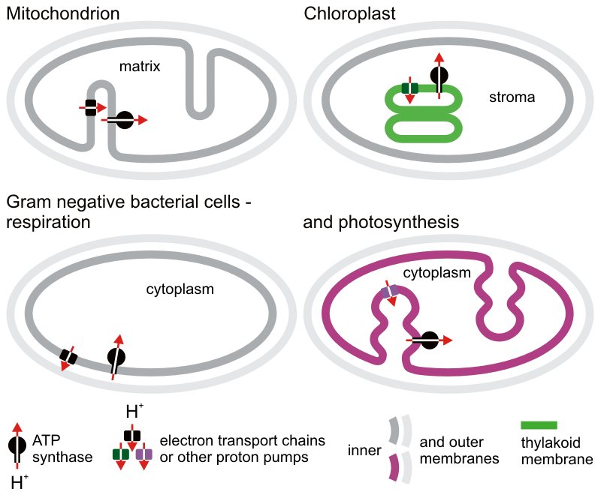
But Don’t Forget!
Some prokaryotes are able to carry out aerobic cellular respiration, and photosynthesis. They have adapted their cell membrane into quasi-compartments.

Slide 6
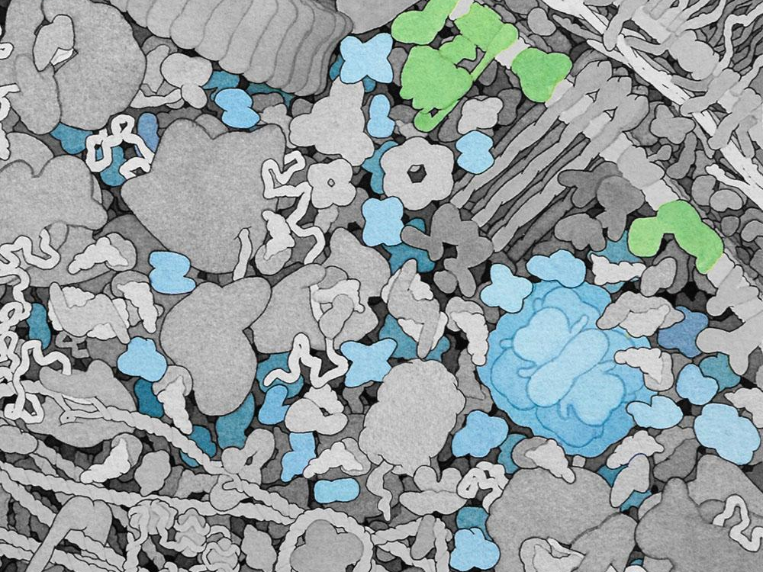
E. coli’s ATP Synthase is embedded in the cell membrane
Image by David S. Goodsell, The Scripps Research Institute. All rights reserved.

Slide 7
Multicellular Compartmentalization
Multicellular organisms have compartmentalized organs and organ systems to increase their efficiency.
All systems work together to accomplish tasks, including metabolism.

Slide 8
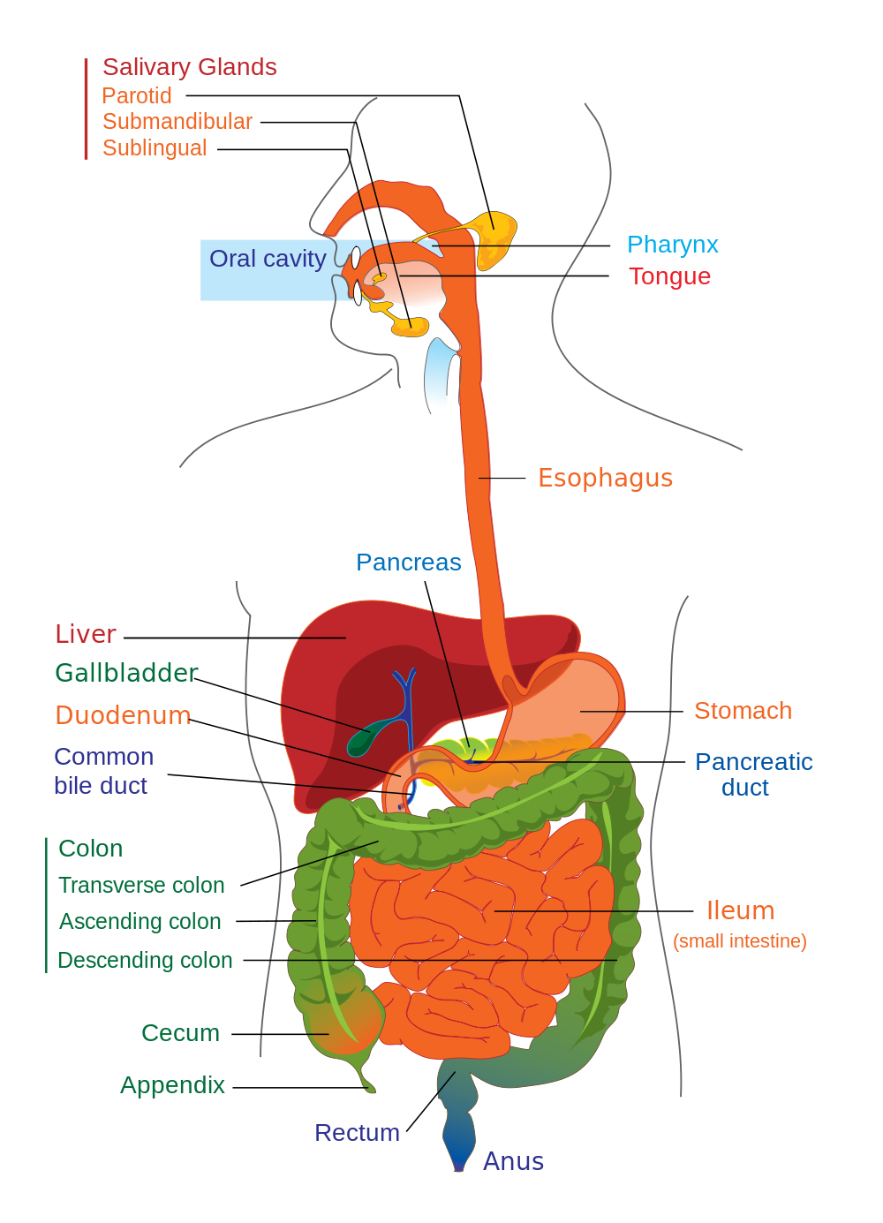
Digestive System
Converts and absorbs complex food molecules in to metabolic inputs (ex. starch into glucose)

Slide 9
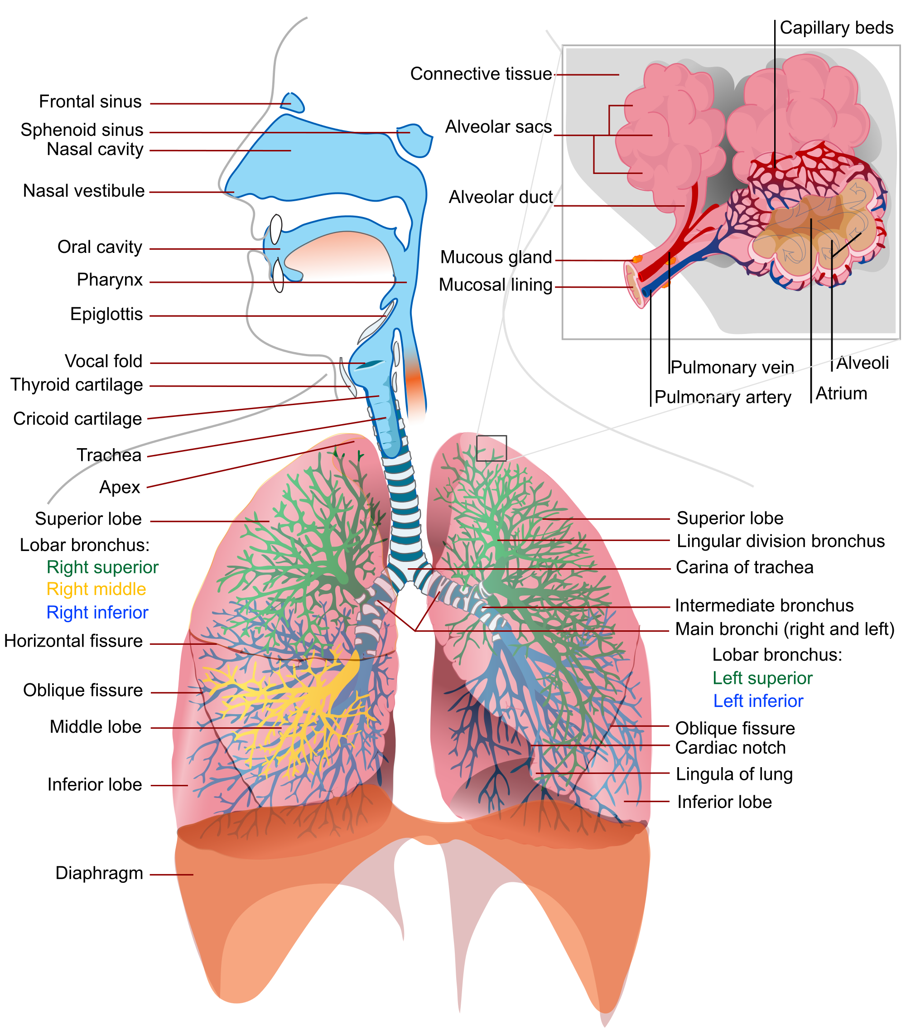
Respiratory System
Exchanges metabolic gases (oxygen and carbon dioxide)

Slide 10
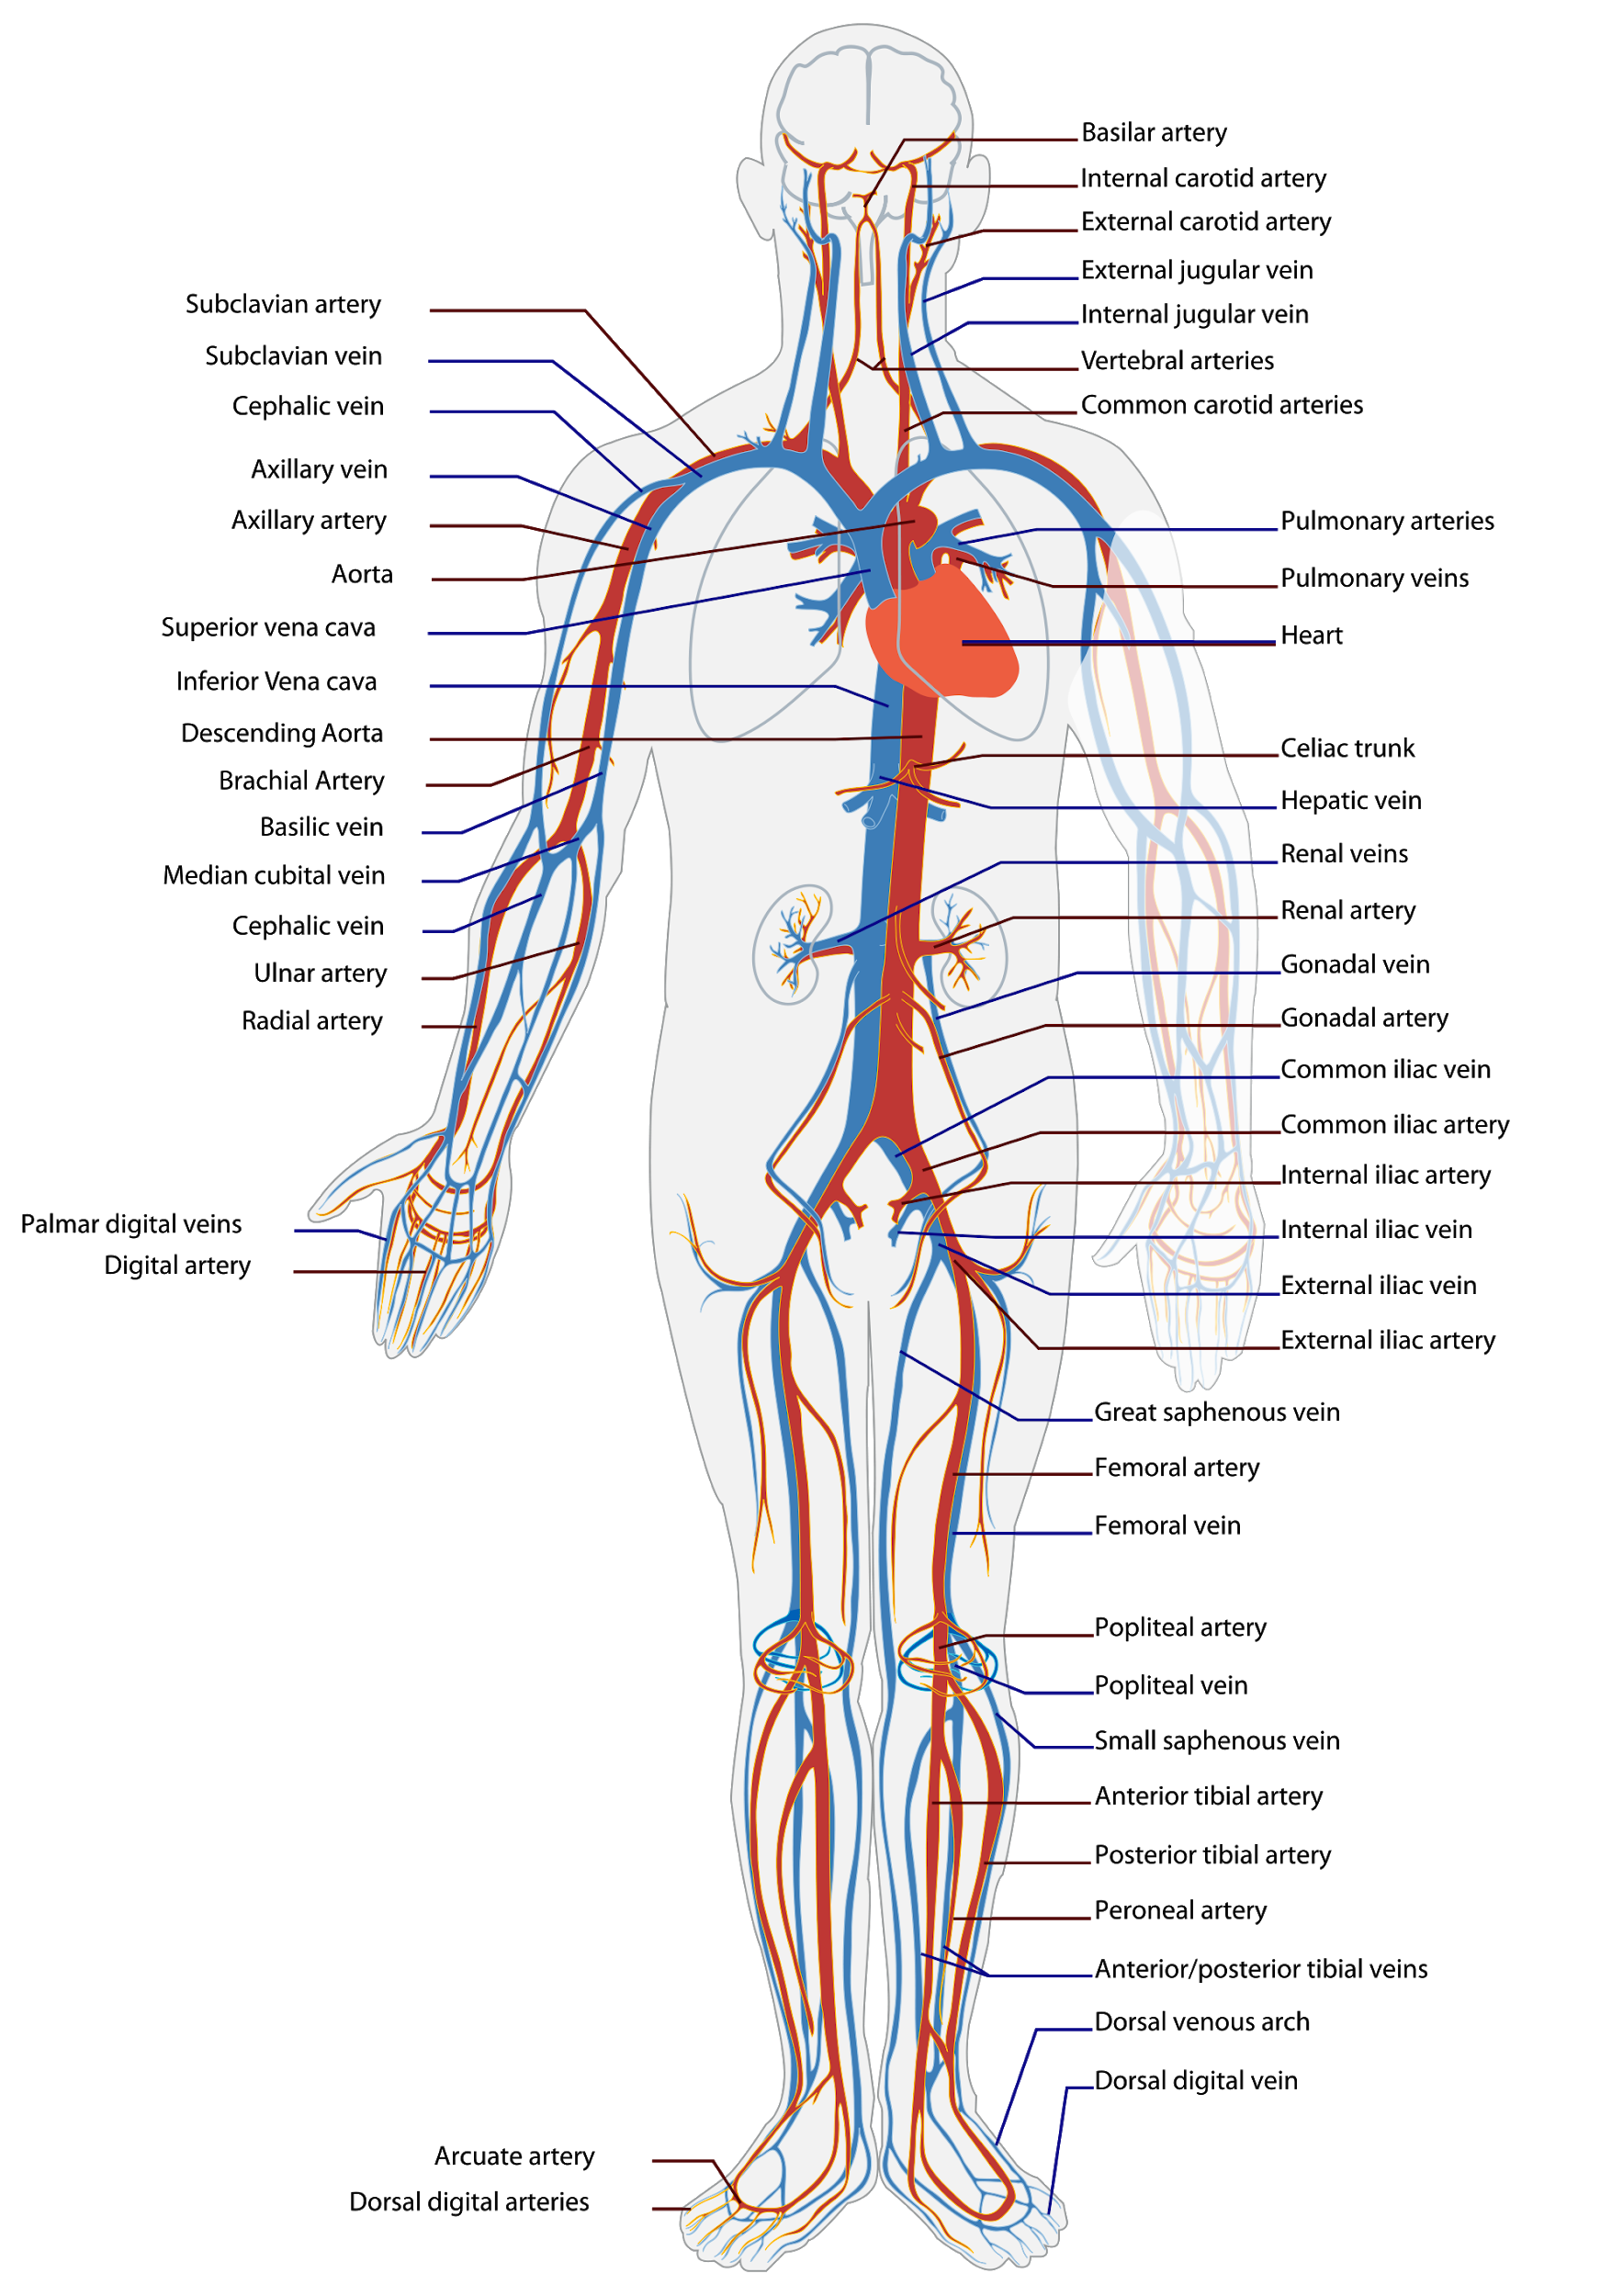
Circulatory System
Delivery of nutrients and removal of waste products from the cells of the body

Slide 11
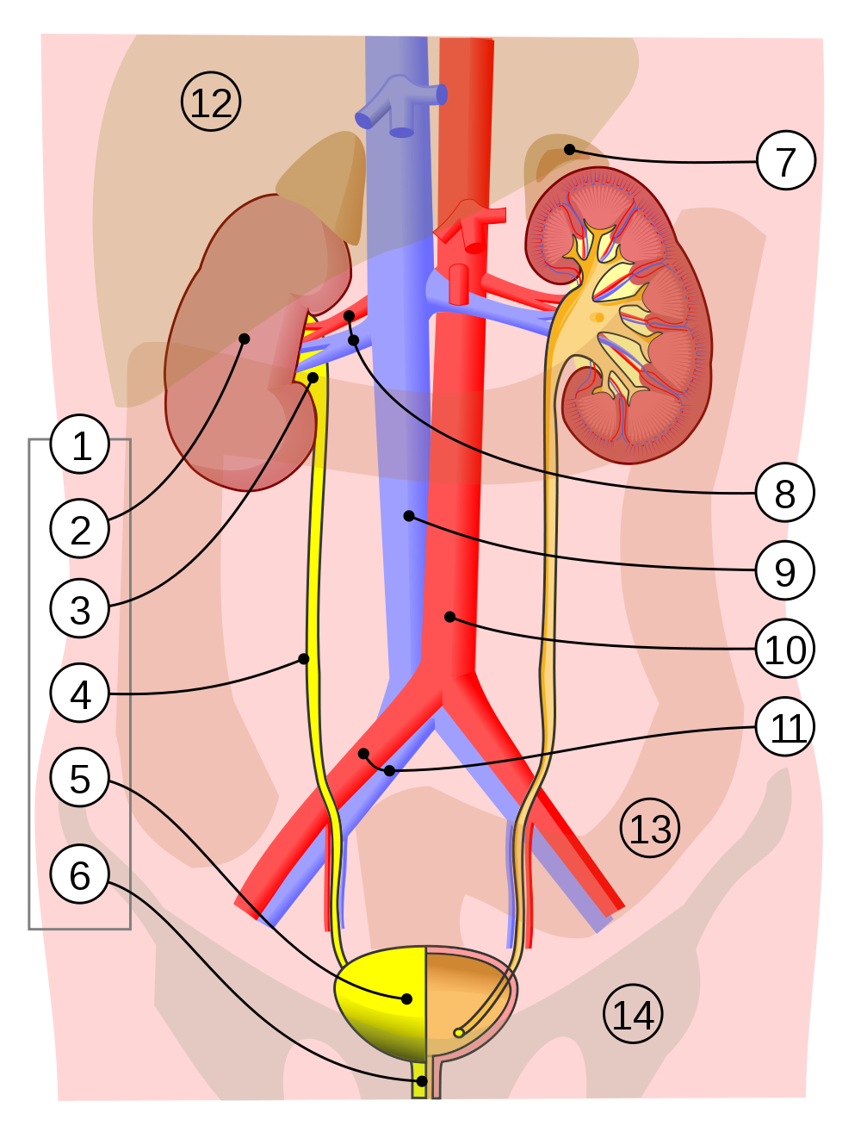
Excretory System
Removal of metabolic waste products (water and nitrogenous wastes) from the body.

Slide 12
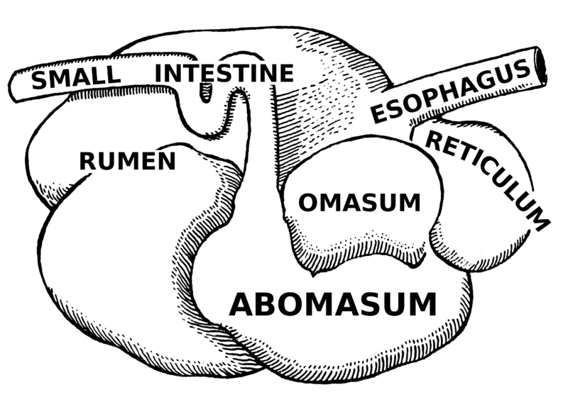
Microbial Cooperation
Communities of microbes will use a diversity of functions to cooperatively accomplish metabolic tasks.
Ex. Animal Rumen Communities

Slide 13
Image Credits
All images taken from wikimedia commons.
Images by David S. Goodsell, the Scripps Research Institute where indicated.

